Slide 1
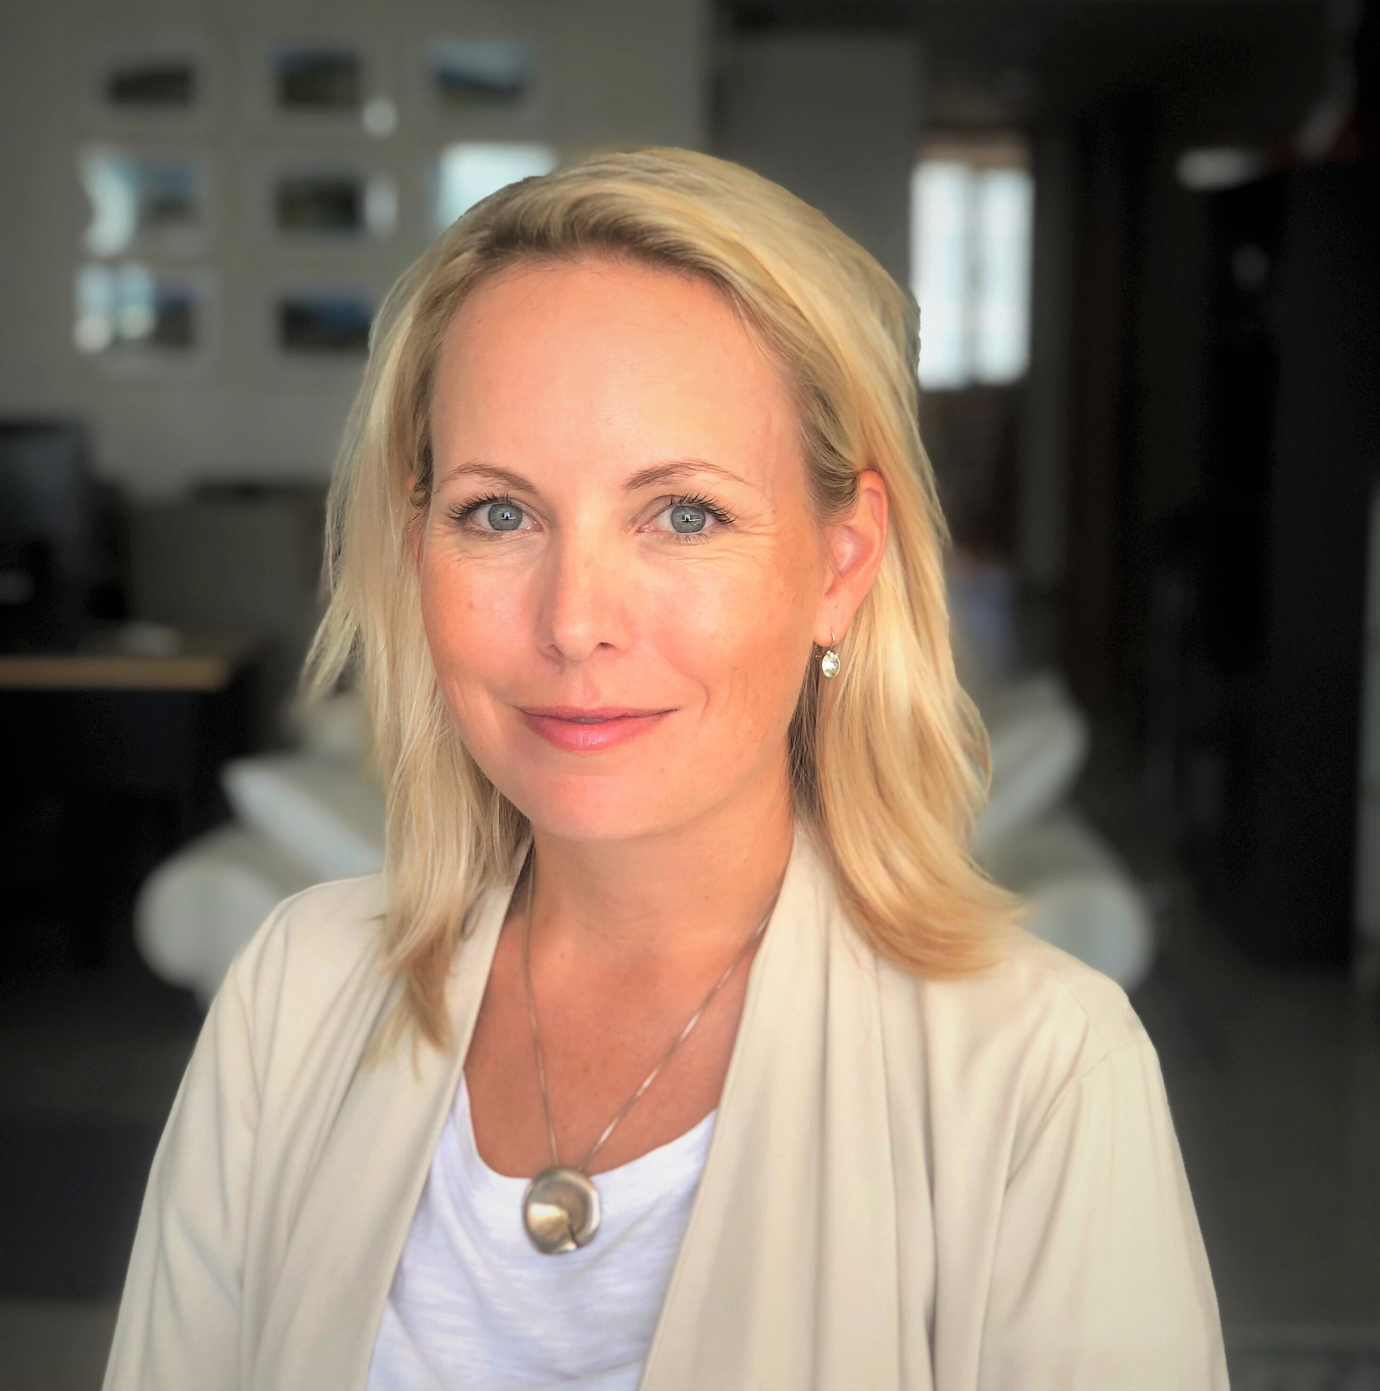
Ransomware, Risk & Recovery
Is Your Hybrid Active Directory Secure from Cyberattacks?
Jacquie Young
VP APAC, Semperis

Slide 2

Active Directory at the Core
Active Directory is fundamental to an organization’s security
It is almost universally targeted in cyberattacks
97% of organizations surveyed say that AD is mission critical
57% say an AD outage would have “severe” or “catastrophic” impact

Slide 3















Active Directory is Central to Hybrid Identity
Active Directory remains the basis for most hybrid identity
93% of Fortune 1000 still rely on AD … and will be for some time
Notes:
1: Takeshi Numoto, CVP STB Marketing, at the May 2013 Cloud OS workshop
2: Recovering Active Directory from Cyber Disasters (https://pages.semperis.com/recovering-ad-from-cyber-disasters), 8/2020

Slide 4

Fundamentals of Active Directory
New user created
company.com
Forest
Sydney DC
sea.company.com
anz.company.com
Replication stream
Forest
  The AD security boundary
  You may have one or multiple forests
Domain
  An administrative boundary within a forest
  A forest can have one, or many domains
Domain Controller
  The Windows server that holds the AD role
  Could be a few, or hudreds
KL
DC
Singapore
DC
DSP
agent
Malaysia DC
Hi there!

Slide 5
Hybrid Identity: On Prem AD & Azure AD
Single
sign on
Active Directory
Username
•••••••••••
SaaS
Azure
Azure AD Connect
Office 365
Salesforce
On-premises
Microsoft Azure Active Directory
Cloud

Slide 6
Why is Active Directory such a target?

Slide 7
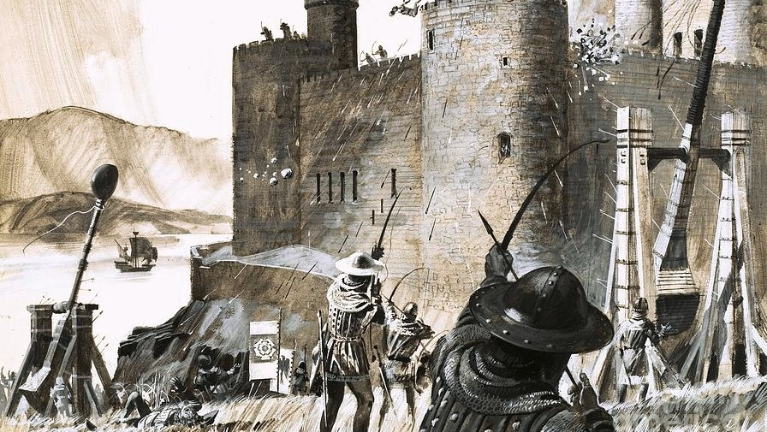
It’s Old
AD security design is from another era
23 year history of giving access, permissions and privileges
Attacks tools of 23 years ago are very different to today
AD skillsets are declining everywhere
Historical division of responsibility between infrastructure & cyber

Slide 8
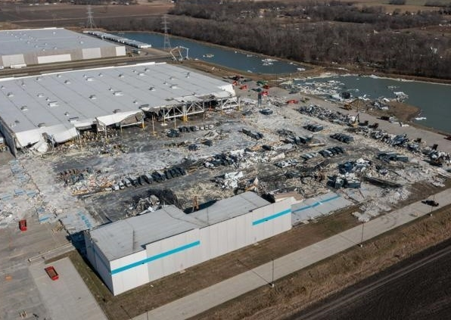
It’s Vulnerable
Classic threats are largely geo centric eg. natural disasters
  Floods, power, wildfires, typhoons
Cyber threats are network centric
  Location is irrelevant
  If you’re on the internet, you’re a target
A cyber attack can kill an entire AD forest in seconds

Slide 9



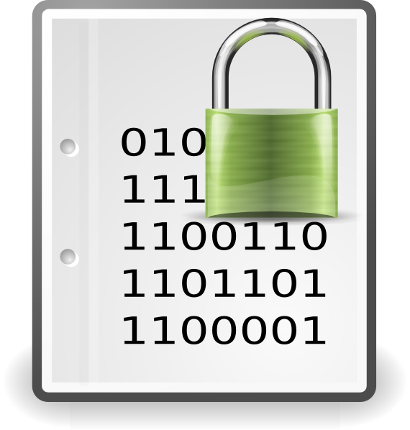
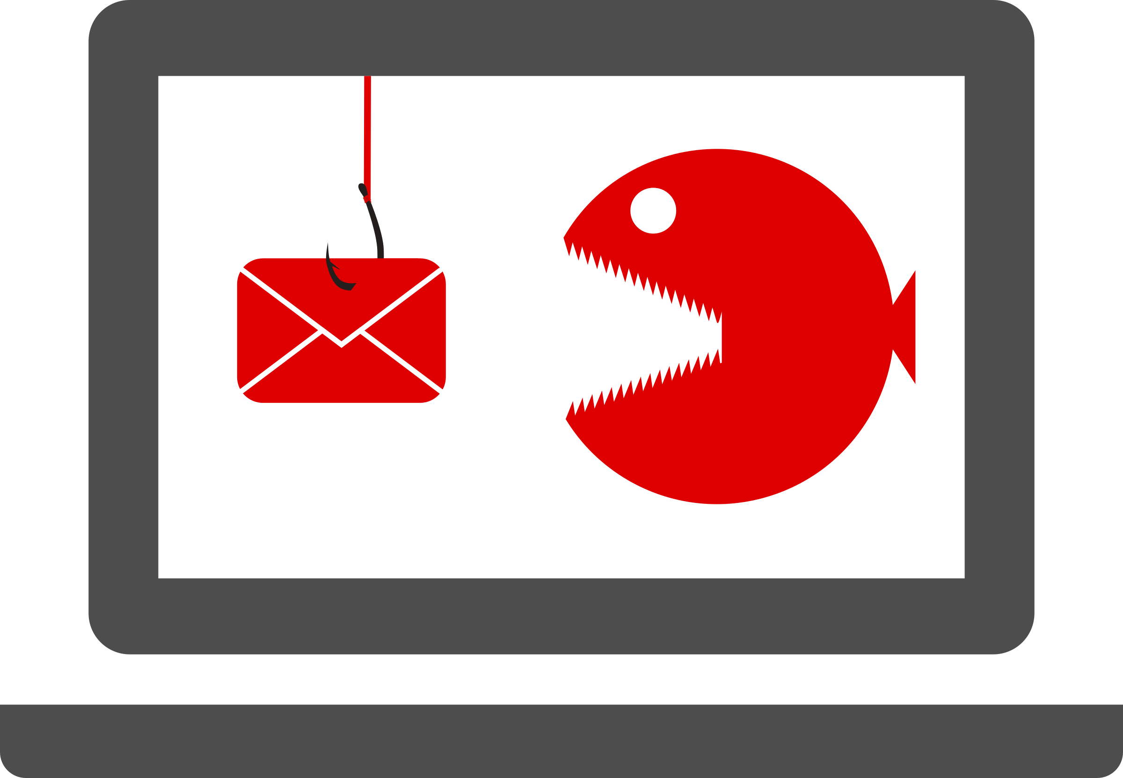
Simple AD Breach with Ransomware
Oops!
Someone accidentally clicks on a phishing email link…
This lets the bad actor in…
malware deployed
The bad actor accesses Active Directory and now has the keys to the kingdom and the ability to edit privileges of every user…
The bad actor elevates their own privileges & makes themselves king & locks you out…
The bad actor now either encrypts your data or event worse your active directory and hold you ransom
Initial access
Reconnaissance
Propagation
Escalation
Exfiltration
Encryption
Could also be…
Stolen credentials
Unpatched exchange
Remote desktop
Unsecure VPN
Do this using Mimikatz/DC Shadow and this will evade SIEM logging
Average ransomware payouts are ~$1m globally and in Asia Pacific

Slide 10
How about a real-life example…

Slide 11
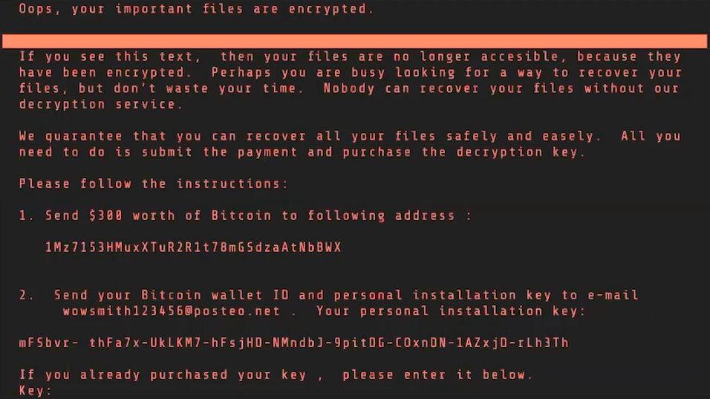
See speaker notes
Notes:
“This happened over 5 years ago, before Russia invaded Ukraine. And Russian attacks are continuing; the “Ukrainian government has counted hundreds of breaches” this year. https://www.wired.com/story/russia-cyberwar-ukraine-target-civilians/
The sad reality is that the vast landscape of corporate Active Directory forests today are as unprepared for a cyberattack – any cyberattack, let alone a Russian cyberweapon – as they were five years ago.”

Slide 12
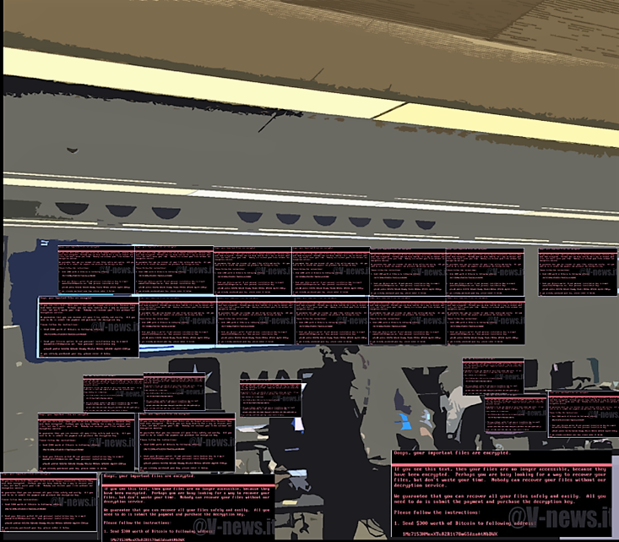
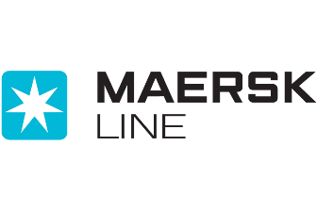
Maersk and NotPetya
World’s largest shipping company
First Russian supply-chain attack (like SolarWinds)
Collateral damage from Russia – Ukraine conflict
Infected through a branch office PC
7 minutes later:
  55,000 devices destroyed
  146 of 147 AD domain controllers down
  All 1200 critical applications offline
CIO slept at the office for 70 days
Estimated NotPetya losses for Maersk: $300m
Estimated NotPetya losses worldwide: $10B
“(NotPetya) is what havoc looks like.”
- Brad Smith, Microsoft President
Notes:
“Description – Experience Gap”
Russia had invaded Ukraine, accompanied by wave after wave of cyberattacks on every part of Ukrainian society, including blackouts
MEDoc a common piece of Ukrainian accounting software
NotPetya took out
Carpet bombed the entire Ukrainian internet
Flattened 300 Ukrainian companies, including 22 banks
Four hospitals in Kiev
Multiple airports
Pretty much every Ukrainian government agency
Estimated $10B damage around the world
Merck, FedEx, Maersk, Mondelez
paralyzing updates to medical record systems in hospitals across the US and causing serious collateral damage to Russian firms, too.
Brad Smith, Microsoft president, on the NotPetya attack

Slide 13
Nine days for an Active Directory recovery isn't good enough. You should aspire to 24 hours. If you can't, then you can't repair anything else.
“
ANDY POWELL, MAERSK CISO

Slide 14
How likely is an AD breach for you?
Tempting target for Ransomware
Revenue & Fame
More:
Bad configs etc over time
Excessive privileges
Harder for you to recover without paying ransom
# of Active Directory Users

Slide 15
How to recover Active Directory

Slide 16
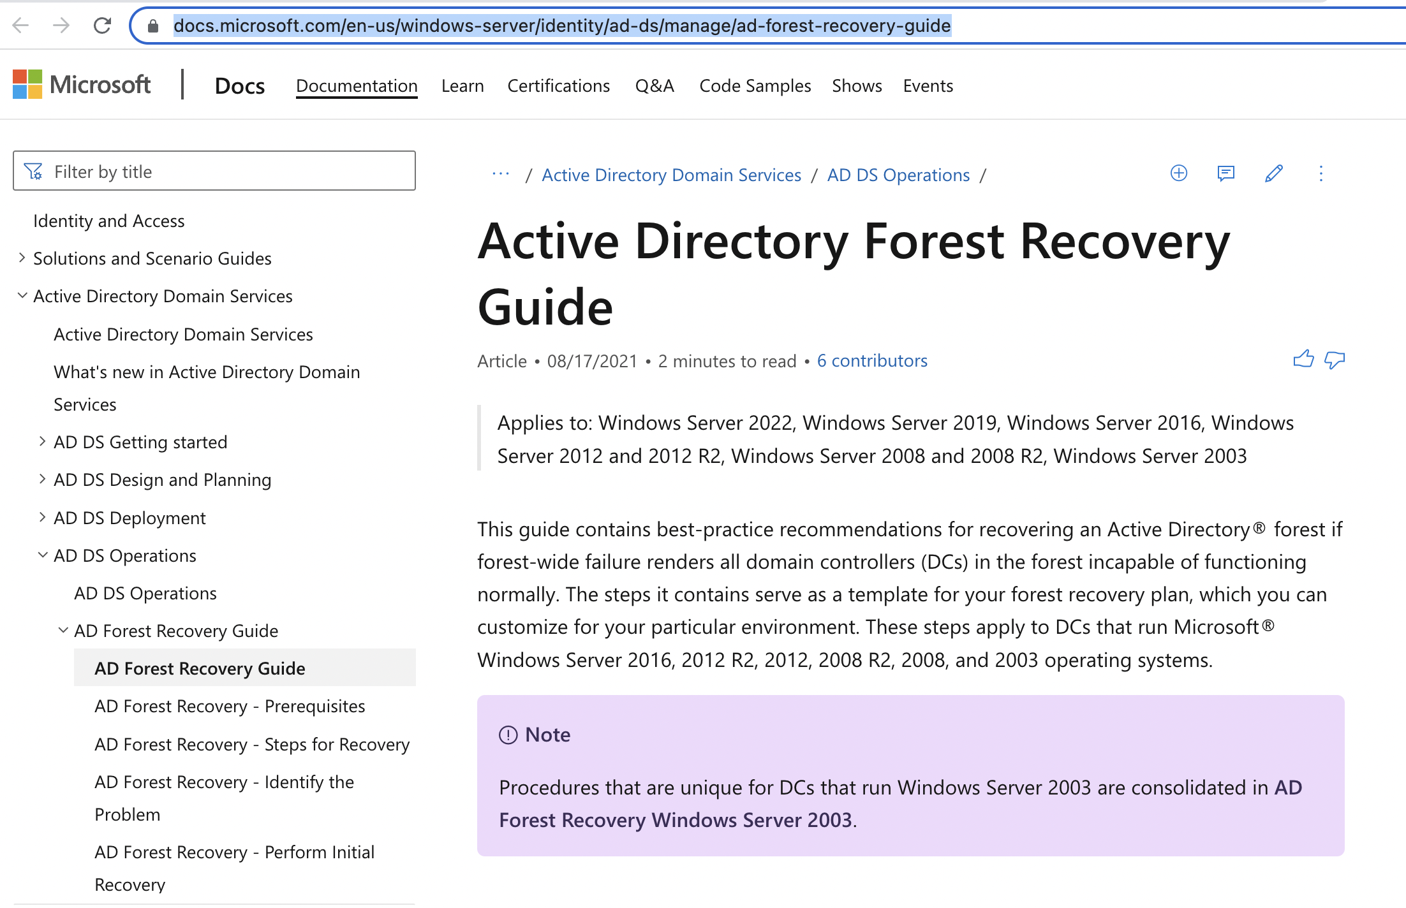
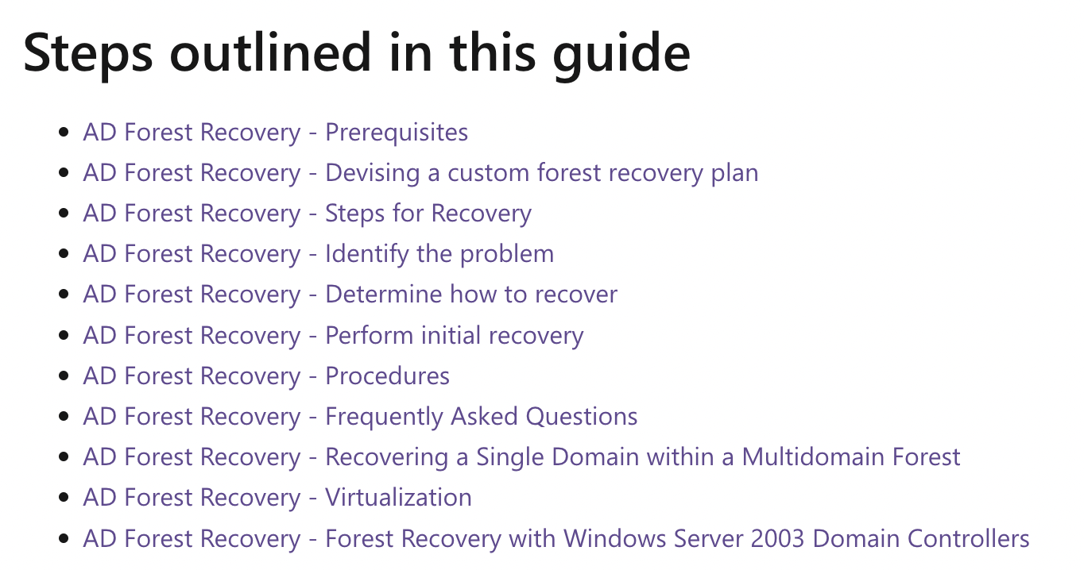
https://docs.microsoft.com/en-us/windows-server/identity/ad-ds/manage/ad-forest-recovery-guide

Slide 17
What Does it Take to Manually Perform a Forest Recovery?
Pull the network cables from all DCs or otherwise disable
Connect DCs to be restored to a private network (oh yes - establish a global private VLAN)
For each domain,
  Nonauthoritative restore of first writeable DC
  Auth restore of SYSVOL on that DC
  Look for malware, etc. Forensic analysis: is it safe to continue?
  Reset all admin account passwords
  Seize FSMOs
  Metadata cleanup of all writeable DCs except for targeted seed forest DCs
  Configure DNS on the forest root DC
  Remove the global catalog from each DC.
  <Wait for GC to unhost…>
Delete DNS NS records of DCs that no longer exist
Delete DNS SRV records of DCs that no longer exist
Raise the RID pool by 100K
Invalidate the current RID pool
Reset the computer account of the root DC twice
Reset krbtgt account twice
  <seed forest at this point>
Configure Windows Time
Verify replication health
Add GC to a DC for each OS version in each domain
  <Wait for GCs to host…>
Take a backup of all DCs in the seed forest
Create an IFM package for each OS version, in each domain, your DCs are running
Build out seed forest with additional DCs to support Tier 0 / Tier 1 operations:
For each DC to be repromoted into the seed forest,
  Clean up the (former) DC using /FORCEREMOVAL or rebuild OS
  Send IFM package to server
  <Wait>
  Take the DC off the public network and put it on the seed forest network.
  Run a DCPROMO IFM
<Days pass…>
<Large enough forest to support basic operations>
Verify health of the full forest
Move restored forest to the corporate network
Notes:
https://docs.microsoft.com/en-us/windows-server/identity/ad-ds/manage/ad-forest-recovery-guide
A statement from Microsoft on the “perform initial recovery steps” page (https://docs.microsoft.com/en-us/windows-server/identity/ad-ds/manage/ad-forest-recovery-perform-initial-recovery) about using VM snapshots to back up your forest: “The restore operation must be completed by using an Active Directory-aware backup and restore application, such as Windows Server Backup (that is, you should not restore the DC by using unsupported methods such as restoring a VM snapshot).”

Slide 18
You can’t outwit/outplay/outlast it unfortunately…
Before an attack
After an attack
What about dwell time?
Dwell time is ~20-200 days
Active Directory
Boot File
Operating
System
What about the AD changes you won’t restore?
105k user AD makes 410k changes PER WEEK and they backup hourly
Too hard and or too slow
I’ll just revert to my backup from before the attack, before malware was on the AD

Slide 19
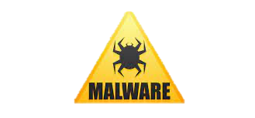
Almost every backup used today can’t recover AD in a cyber breach
Other
Active Directory
BACKUP COMPARISON
Boot File
Sysvol
Operating system,
other volumes
Semperis ADFR vs. other domain controller backups
Active Directory
ADFR
Boot File
Active Directory
Operating
System
Boot File
ADFR backups
✓ Recover in 5 clicks in minutes or hours
✓ Automate the 28 steps in Forest Recovery
✓ Contain no OS → no OS-resident malware in recovery
✓ Remove dependence on source hardware → recover anywhere
✓ Are significantly smaller, require less storage
✓ Provide faster backup and recovery

Slide 20
Identity Threat Detection & Response (ITDR) is now a category of its own

Slide 21

Among Gartner’s top security and risk trends for 2022:
Identity Threat Detection and Response (ITDR)
ITDR is about correct and secure operation of the identity infrastructure rather than protection of individual users and resources managed by this infrastructure. AD TDR tools fulfill this mission by applying threat intelligence, behavioral signatures, heuristics, statistical analysis, analyses of known tactics, techniques and procedures (TTPs) and machine learning algorithms to discover indicators of exposure and indicators of compromise in Active Directory.
Thus, these tools perform both preventive and detective functions, although their relative weights and specific methodologies vary from tool to tool.

Slide 22
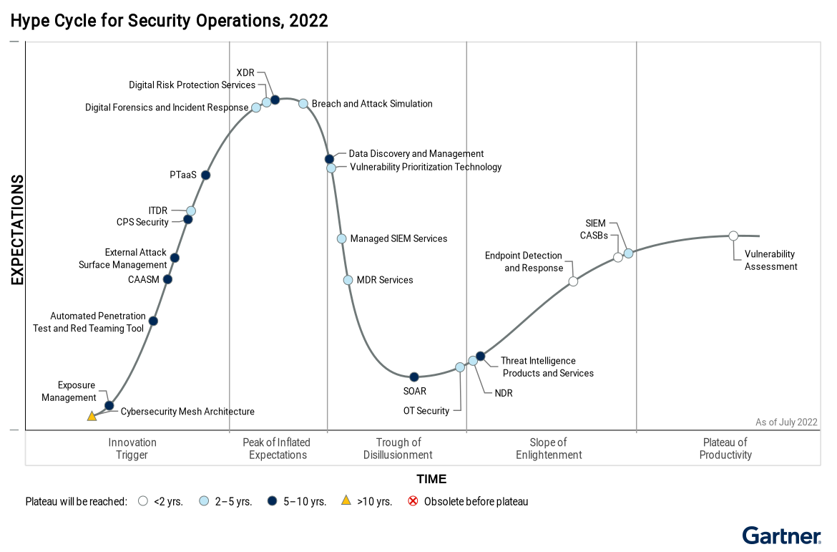
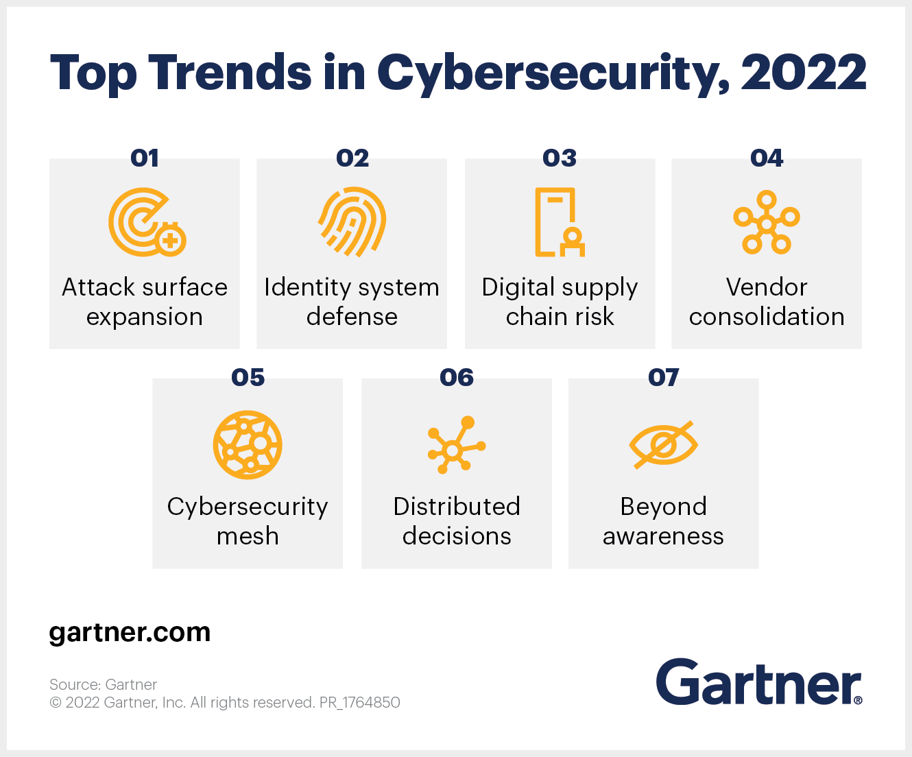
Gartner Hype Cycle 2022 - ITDR
Gartner projects the ITDR market will see mainstream adoption faster than any other category in the "innovation trigger” phase

Slide 23
How can you mitigate risks & recover?

Slide 24
What are IOEs and IOCs?
Indicator of Exposure
Are usually risky configurations within Active Directory and Azure Active Directory (AAD) that attackers can easily exploit.
Often these were out of the box configurations of Active Directory and AAD.
Sometimes there are CVEs for Active Directory as well
Indicator of Compromise
Evidence of compromise, which can signal an in-progress cyberattack in your Active Directory and AAD environment.
6 in both On Prem AD & Azure AD
32 in Azure AD only
112 in On Prem AD only
4 are “CVEs”
More in the works and continually updated by Semperis Research team

Slide 25
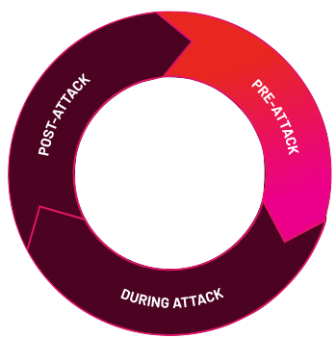

Before an attack
During an attack
After an attack
Forensics & Investigation
IOE & IOC Discovery & Monitoring
Identify
+
+
+
Cyber-First
Disaster Recovery
+
+
Vulnerability Assessments
+
Protect
+
+
Auto-Remediation
& Incident Response
Threat Detection & Visibility

Slide 26
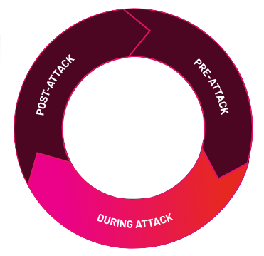
Before an attack
During an attack
After an attack
Forensics & Investigation
IOE & IOC Discovery & Monitoring
+
+
Cyber-First
Disaster Recovery
+
+
Vulnerability Assessments
+
+
+
+
Auto-Remediation
& Incident Response
Threat Detection & Visibility
Respond
Detect

Slide 27
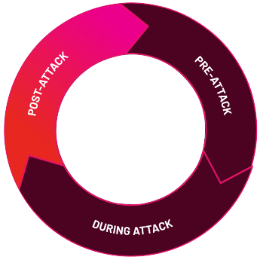
Before an attack
During an attack
After an attack
Forensics & Investigation
IOE & IOC Discovery & Monitoring
+
+
+
Recover
Cyber-First
Disaster Recovery
+
Vulnerability Assessments
+
+
+
+
Auto-Remediation
& Incident Response
Threat Detection & Visibility

Slide 28

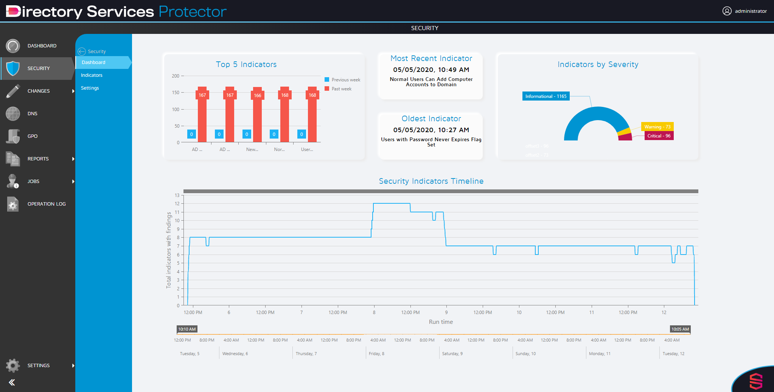
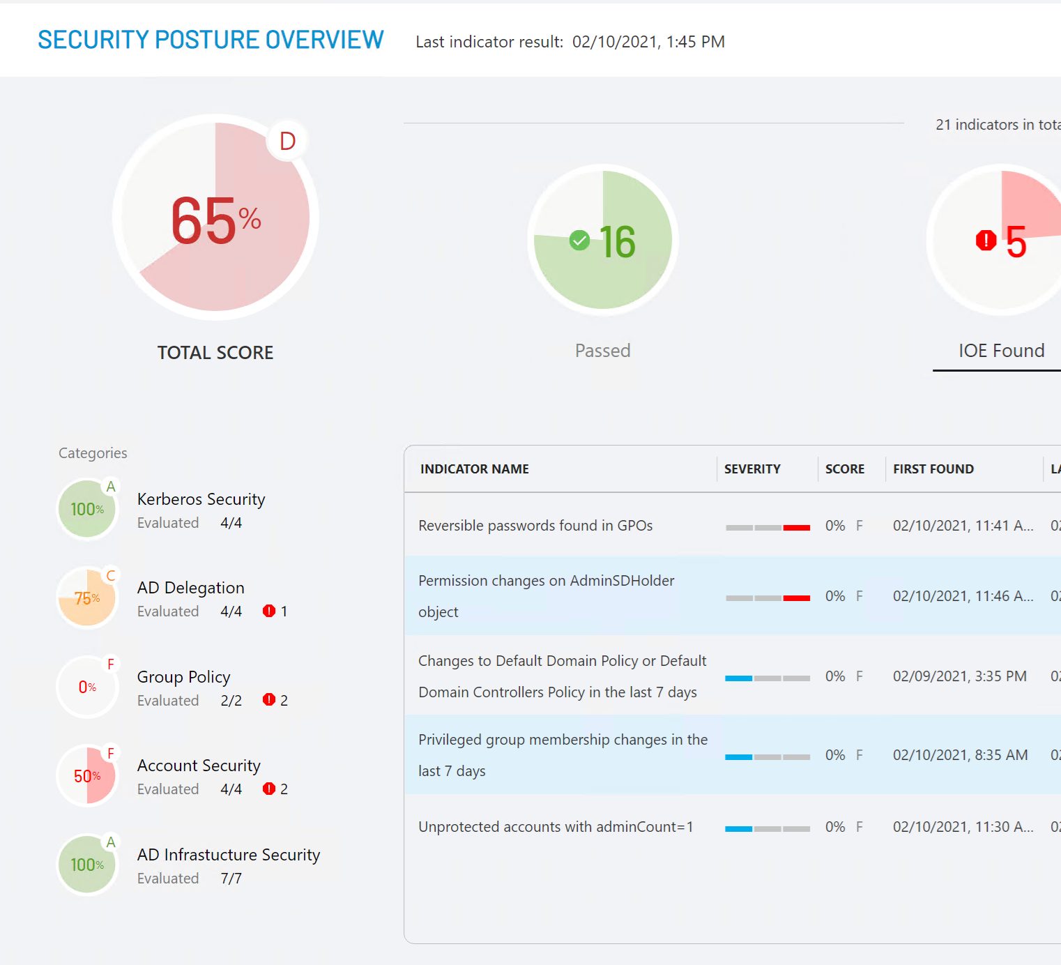
COMPREHENSIVE SECURITY
Monitor, detect, & respond
Continuous vulnerability assessment
Tamperproof tracking
Real-time security alerts
Auto-remediation (malicious change rollback)
Compliance reporting
+
+
+
+
+
Notes:
We've got several product offerings, and there's so much more that we won't be able to get to today. Directory Services Protector is the industry’s most comprehensive identity threat detection and response platform for on-prem AD and Azure AD. Continuous vulnerability assessment, tamperproof tracking, real-time security alerts, auto-remediation, and there's a lot more meat to the platform. Just as an example, we didn't even touch on the compliance and reporting systems.
As a follow-up, I suggest we schedule some time with your broader team, perhaps to dig in a bit deeper on the products and see a live demo.

Slide 29

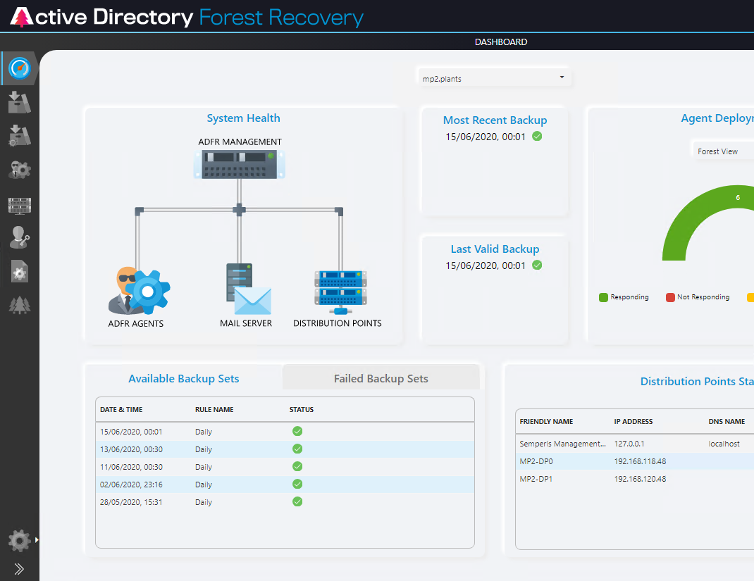
CYBER-FIRST RECOVERY
Shorten forest recovery by 90%
Clean restore (malware free)
Rapid recovery
Advanced automation
Anywhere recovery
Post-attack forensics (PK Post Breach)
Incident response
+
+
+
+
+
+
Notes:
And here's our AD forest recovery product, focused entirely on cyber-first disaster recovery.

Slide 30


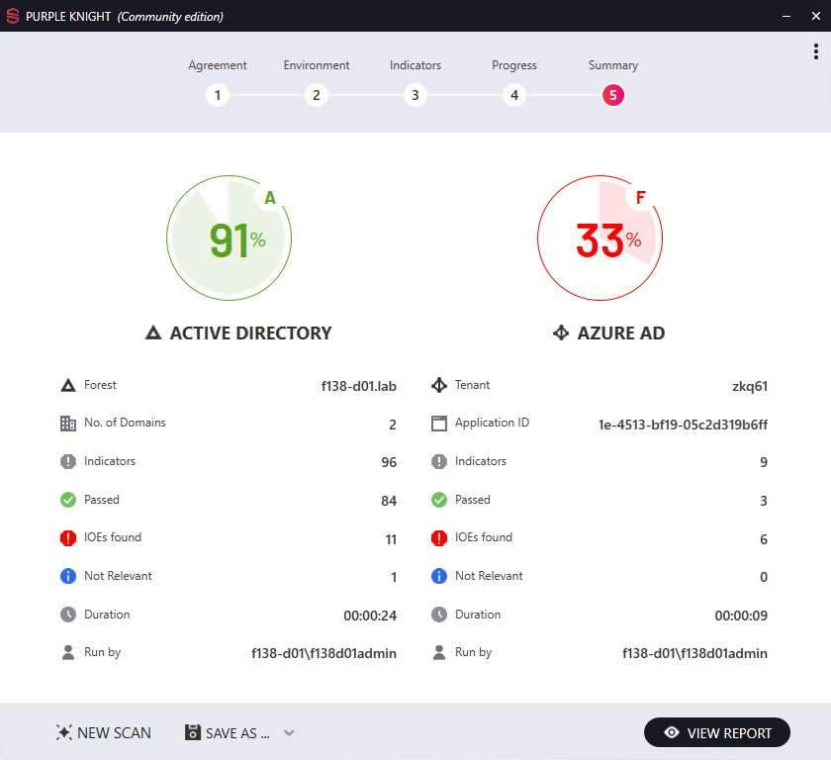
MEET PURPLE KNIGHT
Spot weaknesses before attackers do
Get the #1 community hybrid AD security assessment tool
10,000+ downloads
100+ security indicators
45% attack surface reduction
Learn more at purple-knight.com → ​
Notes:
I’ll leave you with a call to action to start on your journey to beefing up your hybrid AD security. The best first step is to download Purple Knight, which will perform a comprehensive set of tests against the most common and effective attack vectors to uncover risky configurations and security vulnerabilities within your AD environment. It's free to download and use, and it's becoming very popular with security practitioners. Fair warning, most fail the first assessment. The average score is 61%, with Kerberos security being the top risk area.
Let me know if you'd like me to send over the download information, and your team can give the tool a spin.

Slide 31

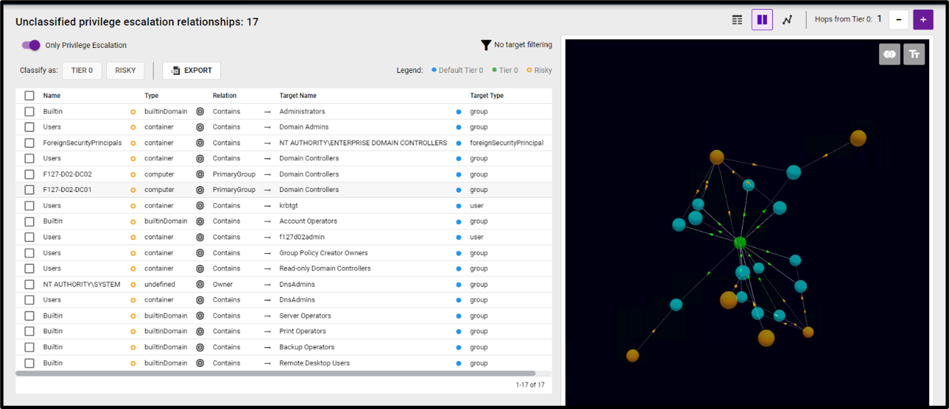
INTRODUCING FOREST DRUID
Stop chasing AD attack paths.
Focus on your Tier 0 perimeter
Identify the true Tier 0 perimeter
Cut down excessive privileges
Monitor what matters—excessive privileges
Prioritize attack paths by severity, not commonality
Save time and resources
Forest Druid automatically graphs relationships among Tier 0 objects, reducing analysis time to identify the highest-risk Active Directory attack paths.
Learn more at purple-knight.com/forest-druid → ​
Notes:
I’ll leave you with a call to action to start on your journey to beefing up your hybrid AD security. The best first step is to download Purple Knight, which will perform a comprehensive set of tests against the most common and effective attack vectors to uncover risky configurations and security vulnerabilities within your AD environment. It's free to download and use, and it's becoming very popular with security practitioners. Fair warning, most fail the first assessment. The average score is 61%, with Kerberos security being the top risk area.
Let me know if you'd like me to send over the download information, and your team can give the tool a spin.

Slide 32


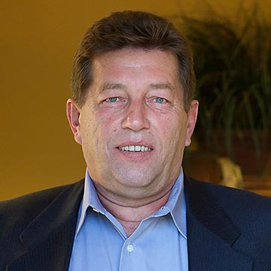
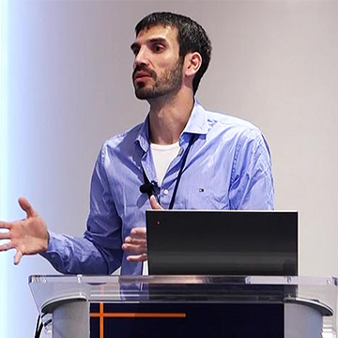
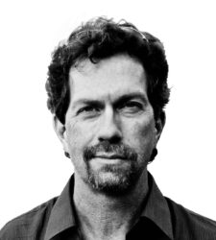

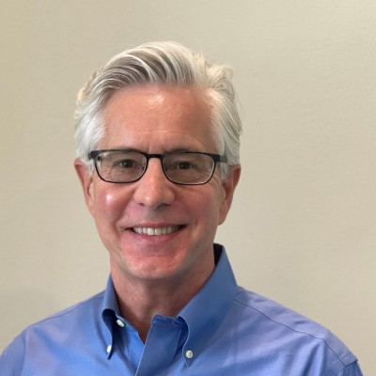
No vendor or services provider can outmatch Semperis’ collective Microsoft MVP experience in Directory Services and Group Policy
Guido Grillenmeier | Chief Technologist (MVP)
Former Chief Technologist at HP | DXC Technology
DOMAIN EXPERTISE
Gil Kirkpatrick | Chief Architect (MVP)
Former Chief Architect at Quest Software
100+ years’ Microsoft MVP experience
Igor Baikalov | Chief Scientist
Former SVP, Global Information Security at Bank of America
Microsoft Ventures Alumni | Azure Co-sell Partner | Cloud Alliance
Guy Teverovsky | CTO (MVP)
Former Senior Premier Field Engineer at Microsoft
Sean Deuby | Director of Services (MVP)
Former Lead Active Directory Architect at Intel
Darren Mar-Elia | VP of Products (MVP)
Former CTO Windows Division at Quest Software aka “GPO Guy”
James (Jim) Dogget | CISO
Former Chief Technology Risk Officer at AIG

Slide 33

Questions to ask oneself…
How long would this take me?
Am I seeing IOEs and IOCs in the replication stream today?
How am I remediating malicious changes today?

Slide 34
How we can help…
Current state analysis
www.purple-knight.com
Engage our 100+ years of Microsoft MVP experience to understand your current state & how to improve your response
Deploy Semperis DSP & ADFR technology to automate how you identify, protect, detect, respond and recover from AD breaches
Engage our Incident Response team 24/7 whether you are a customer or not
Semper Paratus: Always ready
And always a force for good.

