Slide 1



Cyber Security Challenges and Way Forward
Sabah STATE government

Slide 2
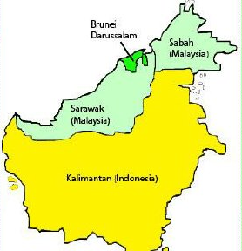
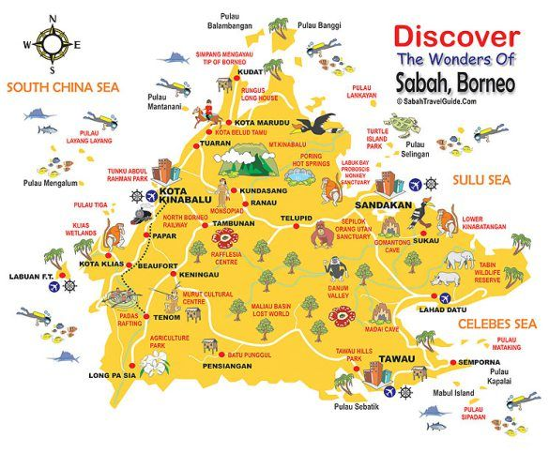

About Sabah
Notes:
Sabah is not exactly known as a Silicon Valley of the east; it is more known for its mountain, jungle and islands (eco tourism)
Yet... we see our fair share of cybersecurity incidents. Hacking attempts : averages more than 20,000 every single day
Everybody has become a target (even Sabah!)

Slide 3
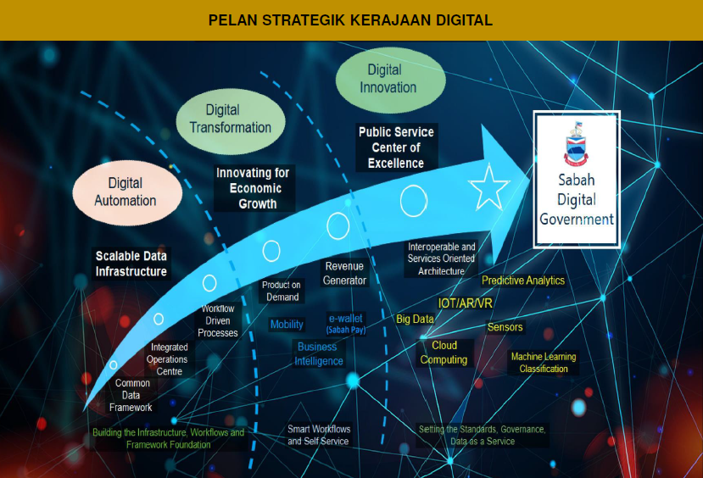
Current cyber security strategy and policies in Sabah
2020: Sabah Digital Government Strategic Plan 2020-2024 launched
2021: Sabah Development Plan (Hala Tuju Sabah Maju Jaya) 2021-2025 launched: Digital Government initiative prominent
Notes:
The Sabah state government had demonstrated its commitment to ICT matters with the setting up of a specific ministry championing ICT, which is the Ministry of Resource Development and ICT Advancement, in 2000/2001.
The State Government ICT Security Committee was a high level committee chaired by the State Government CIO to specifically look into cyber security matters of the state’s public sector.
The state government has been more intensely focused on digitalisation starting in 2019, where more applications are being developed than ever before, especially government services for the public, hence open to the internet.

Slide 4

Current cyber security strategy and policies in Sabah
State Ministry of Science, Technology & Innovation
  Strategic Plan 2022-5, launched April 2022
    Strategic core: Enhance cyber security eco system
      Strategy: Enhance and cultivate cyber security
        Implement cyber security programs
        Implement Celik Digital (digital savvy) programs
        Implement personal data protection awareness programs
        Adapt Digital ID & Digital Signature Infrastructure

Slide 5
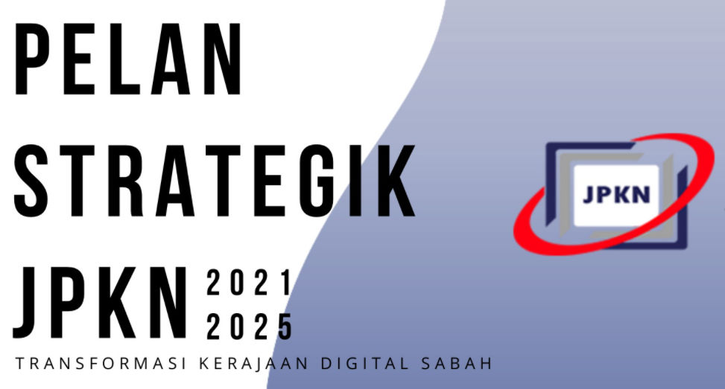
Current cyber security strategy and policies in Sabah
State Computer Services Department
  Strategic Plan 2021-2025
    A Strategic Core: Enhance Cyber Security
      Program 1: Enhance Data Security
        Revamp Application Development Practices
        Implement periodic pre-emptive pen tests
        State Public Sector Cyber Security Policy refresh
        Close cooperation with other agencies in monitoring
      Program 2: Enhance Infrastructure Security
        Data centre resilience

Slide 6



Protecting critical infrastructures
People
  Zero Trust Mindset
Process
  Certifications & assessments
  Sabah Public Sector Cyber Security Policy
Technology
  Security solutions & layers

Slide 7
Top threats & challenges
Current
  Fraud
  Mobile devices
  Decreasing vigilance
  Higher expectations
    More apps to produce, faster
  Existing apps at risk of becoming neglected
New
  Increasing complexity: more “doors & windows”
  Too many solutions

Slide 8
Thank You

