Slide 1
CISO MALAYSIA
SECURITY AND RESILIENCY:
Global Overview of Cyber Threats and Attacks
16 February 2023
Dato’ Ts. Dr. Haji Amirudin Abdul Wahab (Fasc),
Chief Executive Officer
CyberSecurity Malaysia
Notes:
25 min

Slide 2

OUR DIGITAL WORLD TODAY

Slide 3
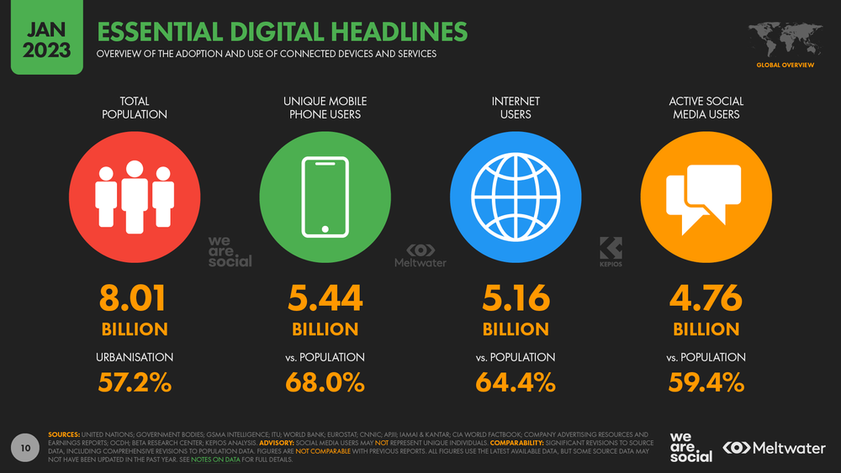
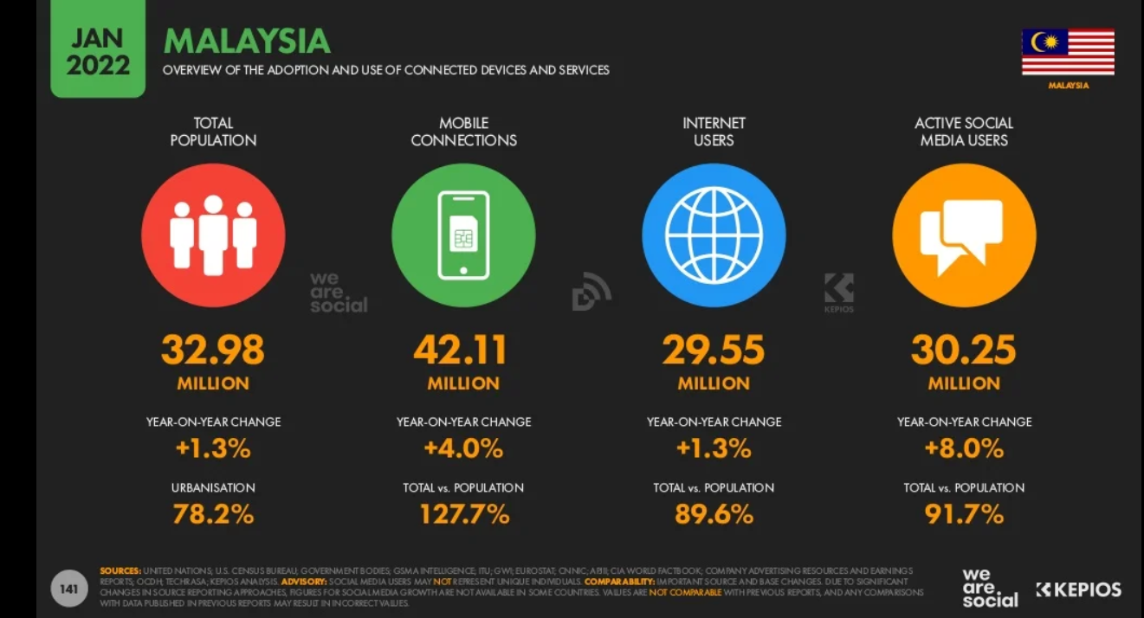

WE ARE MOVING INTO A MORE INTERCONNECTED CYBERSPACE
Digital 2023: Global Overview Report — DataReportal – Global Digital Insights

Slide 4

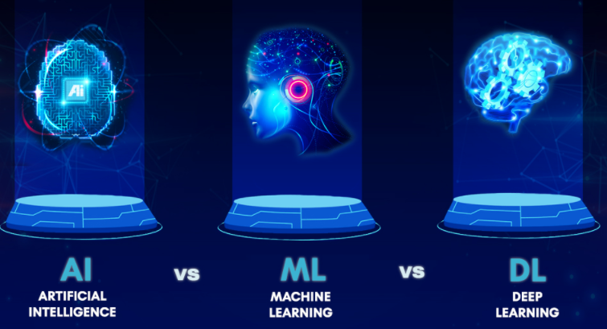

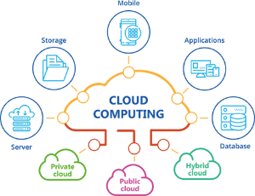

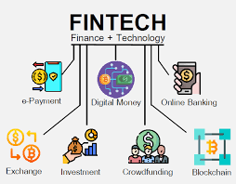
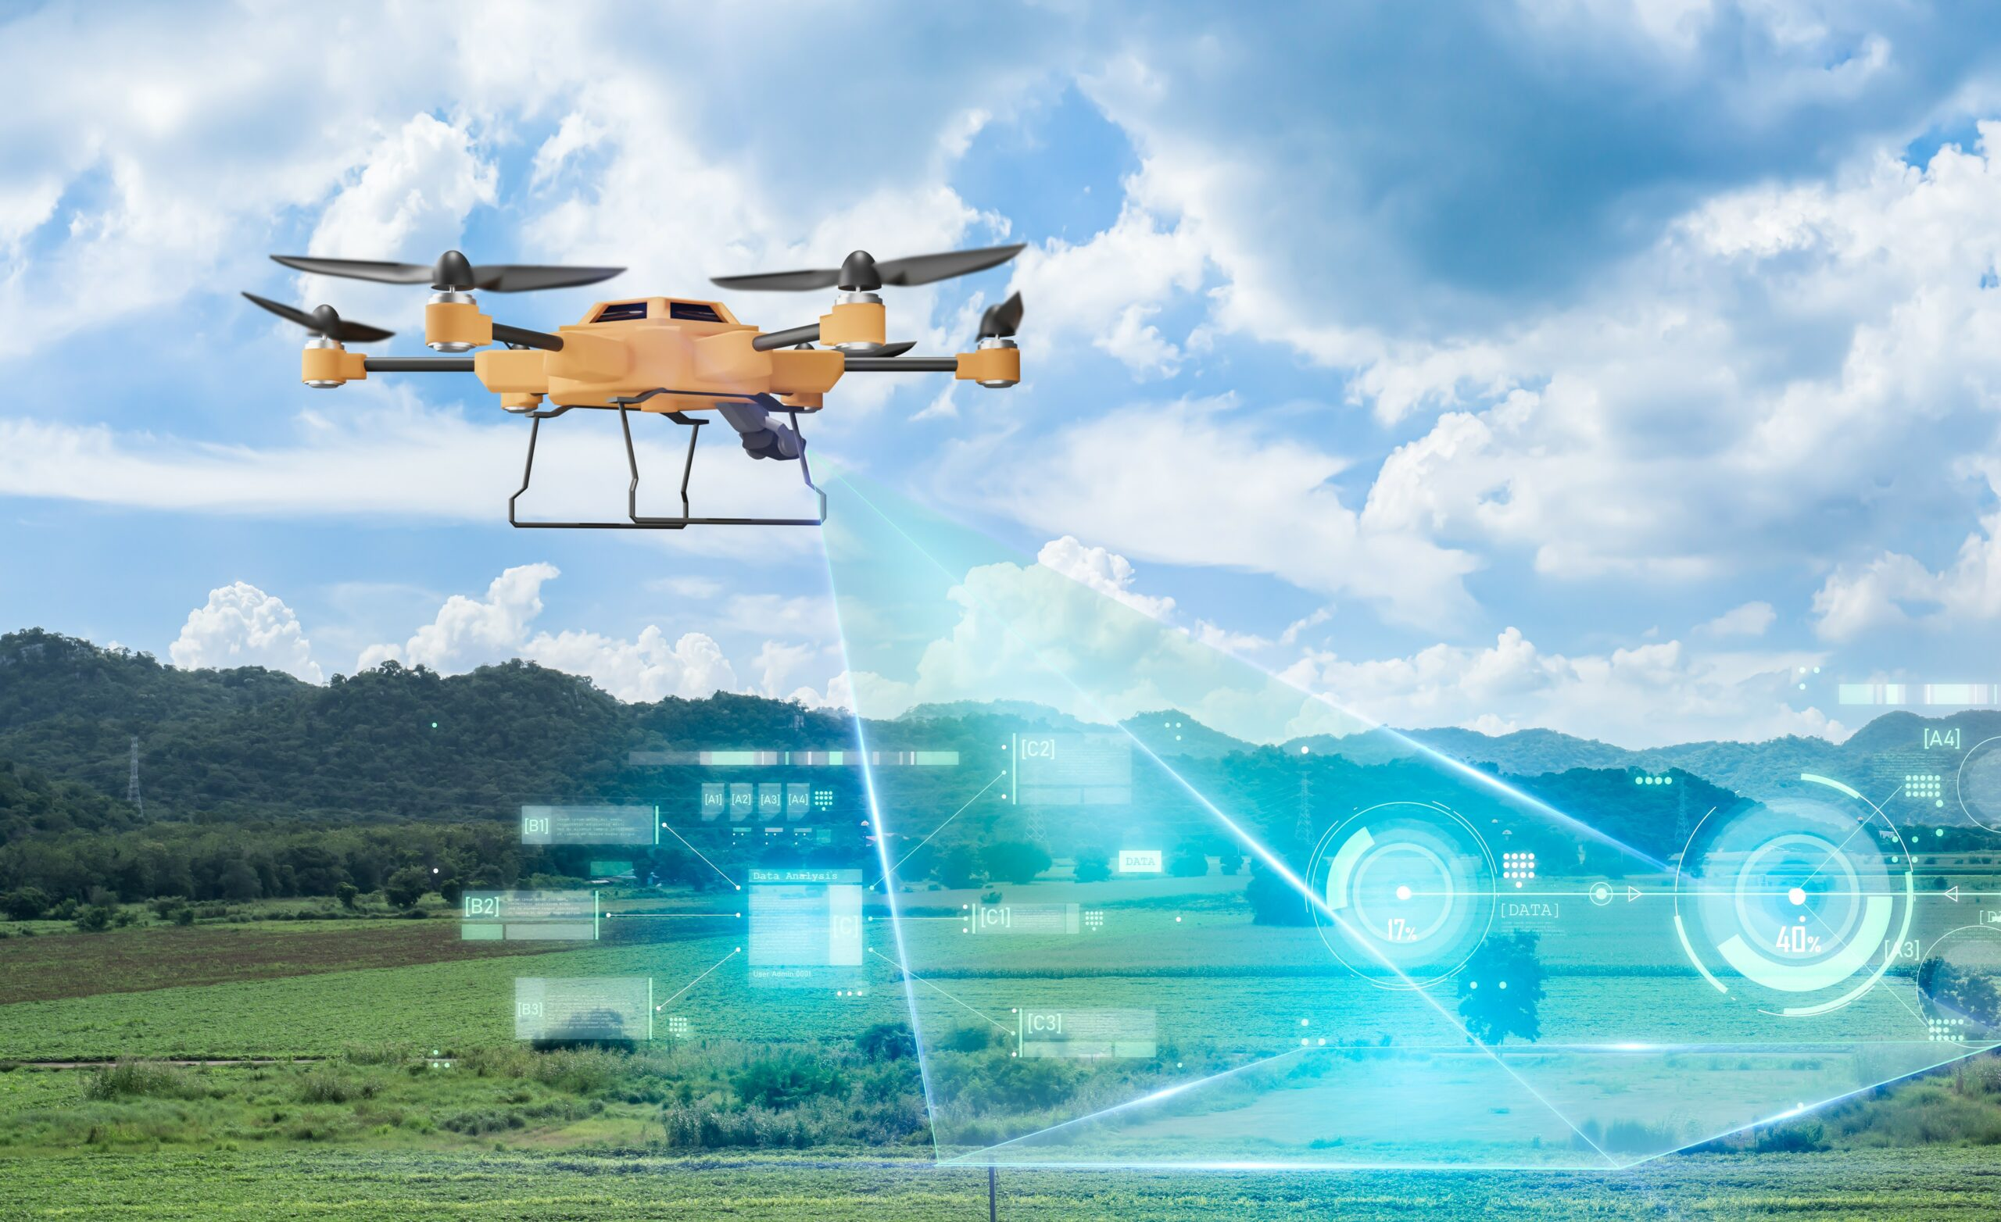

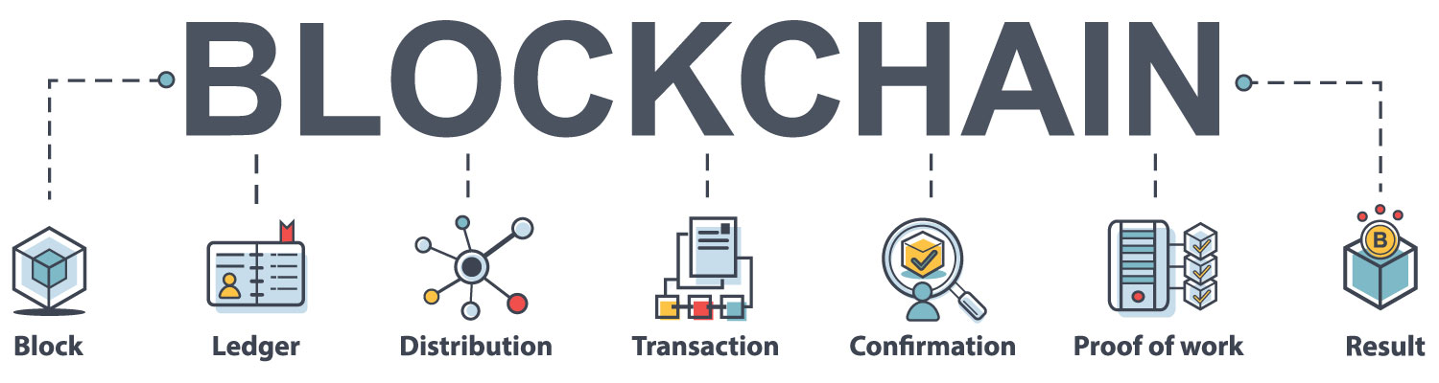
CONVERGENCE OF TECHNOLOGIES
Add More Complexities to Cyber Space

Slide 5
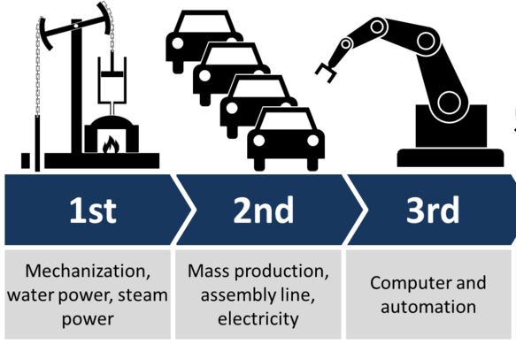
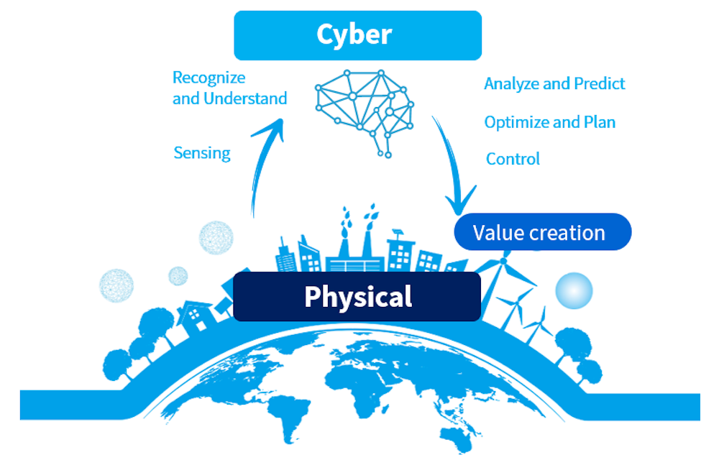

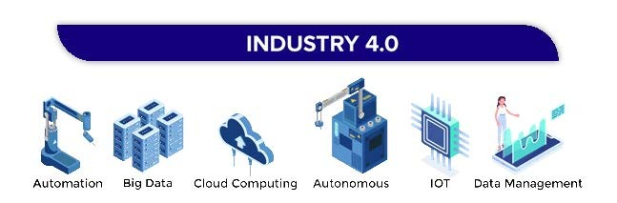

DIGITAL TRANSFORMATION
Thinking Space
Social Space
This shows a Smart World whereby there is deep convergence between the new cyberspace and the traditional ones such as physical, social and also thinking space.

Slide 6

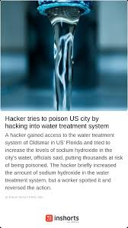
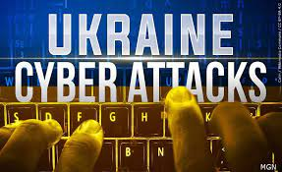

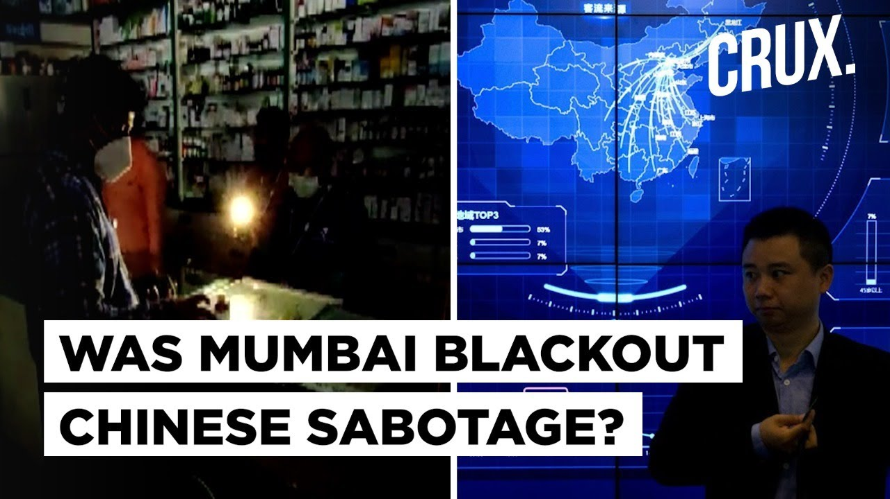
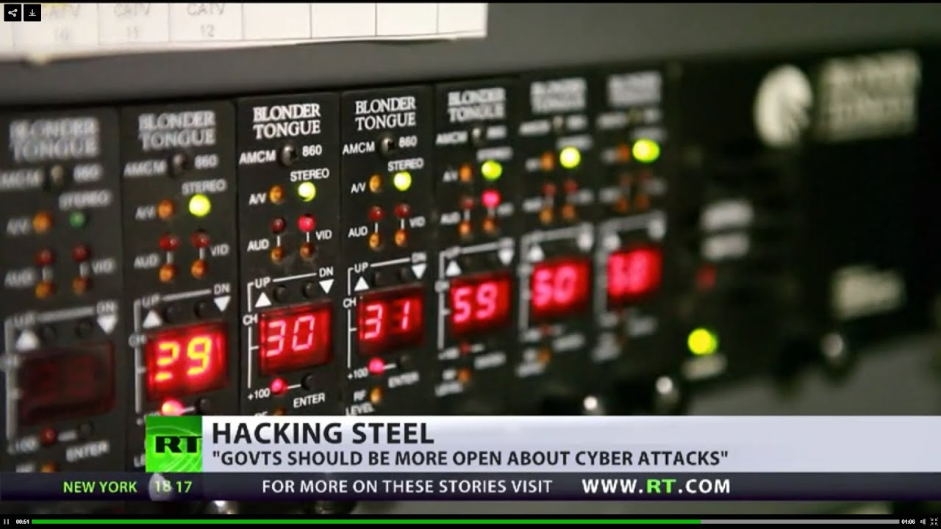
DIGITAL TRANSFORMATION IS NOT
WITHOUT ITS RISK
CYBER-ATTACKS MAY HAVE PHYSICAL CONSEQUENCES
Technology such as wireless technology has changed the way we conduct business, offering workers with constant access to business-critical applications and data. While this flexibility is convenient and expands productivity, it introduces complexity and security risk as these new technology and devices become new target for hackers looking to infiltrate a corporate network.

Slide 7
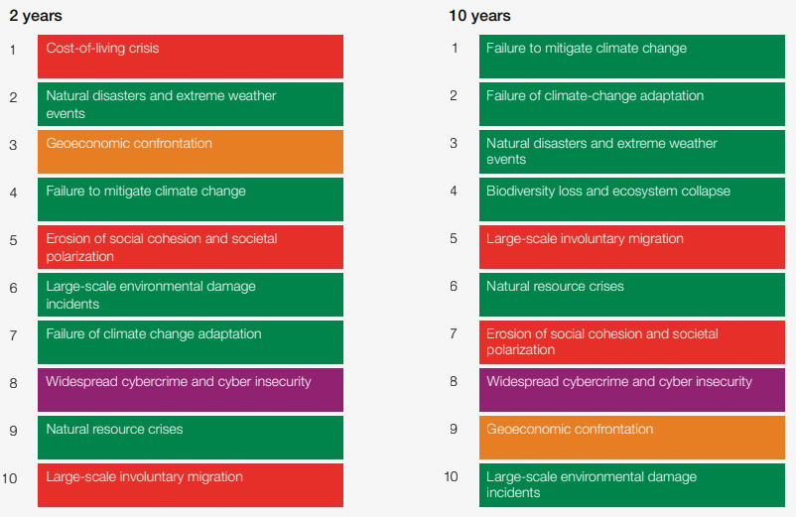
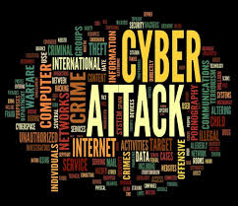
GLOBAL RISK 2023
Source: WEF_Global_Risks_Report_2023.pdf (weforum.org)

Slide 8

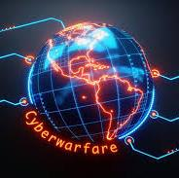
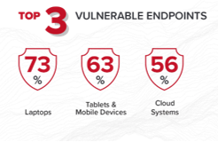
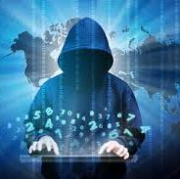
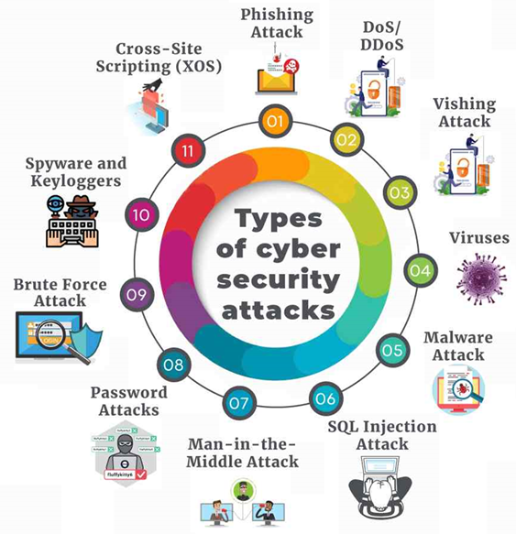



THE MORE WE’RE INTERCONNECTED TO THE CYBER SPACE
THE MORE WE ARE AT RISK TO CYBER THREATS
CYBER THREATS BECOMING MORE ACTIVE AND EVOLVING
CYBER TERRORISM
NATION-STATES CYBER-ATTACKS
CYBERCRIMINALS
Source: https://www.insightsforprofessionals.com/it/security/types-of-security-threat
HACKTIVIST
INSIDER THREATS
PRANKSTER

Slide 9
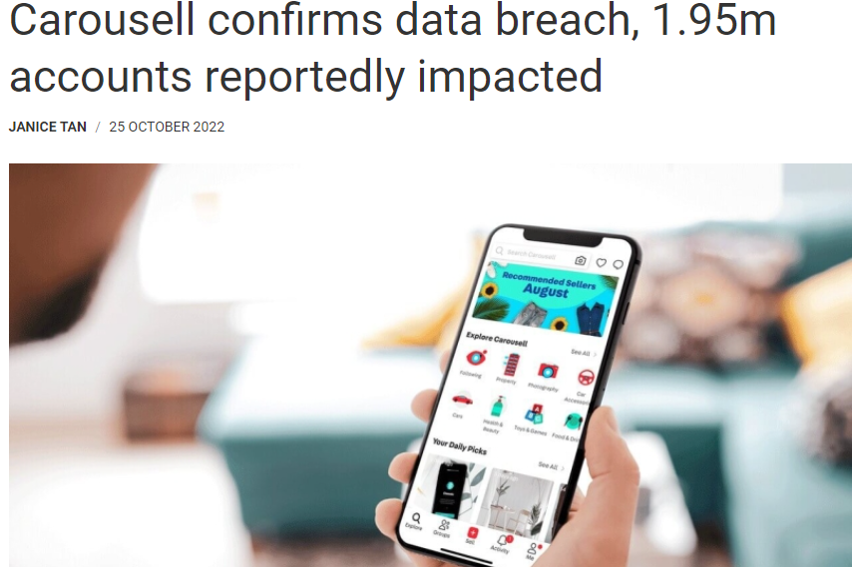
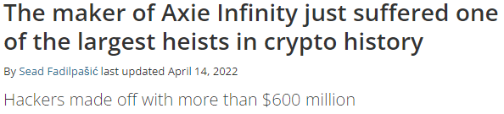
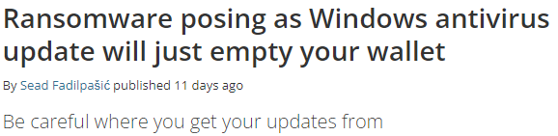
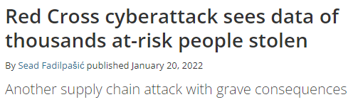
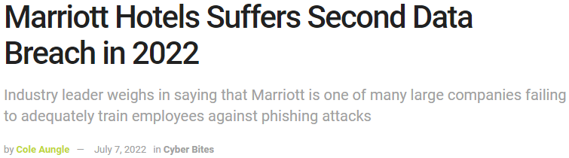

THE MORE WE ARE INTERCONNECTED
THE MORE WE ARE EXPOSED
GLOBALLY

Slide 10
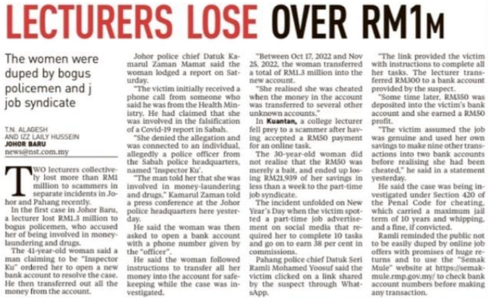
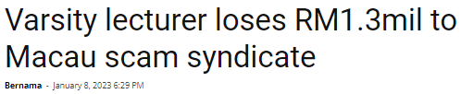


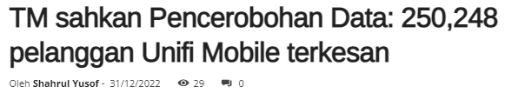

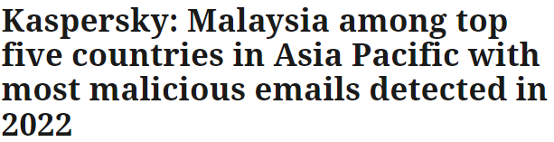


CYBERCRIME OCCURS EVERYWHERE
EVEN IN
MALAYSIA

Slide 11

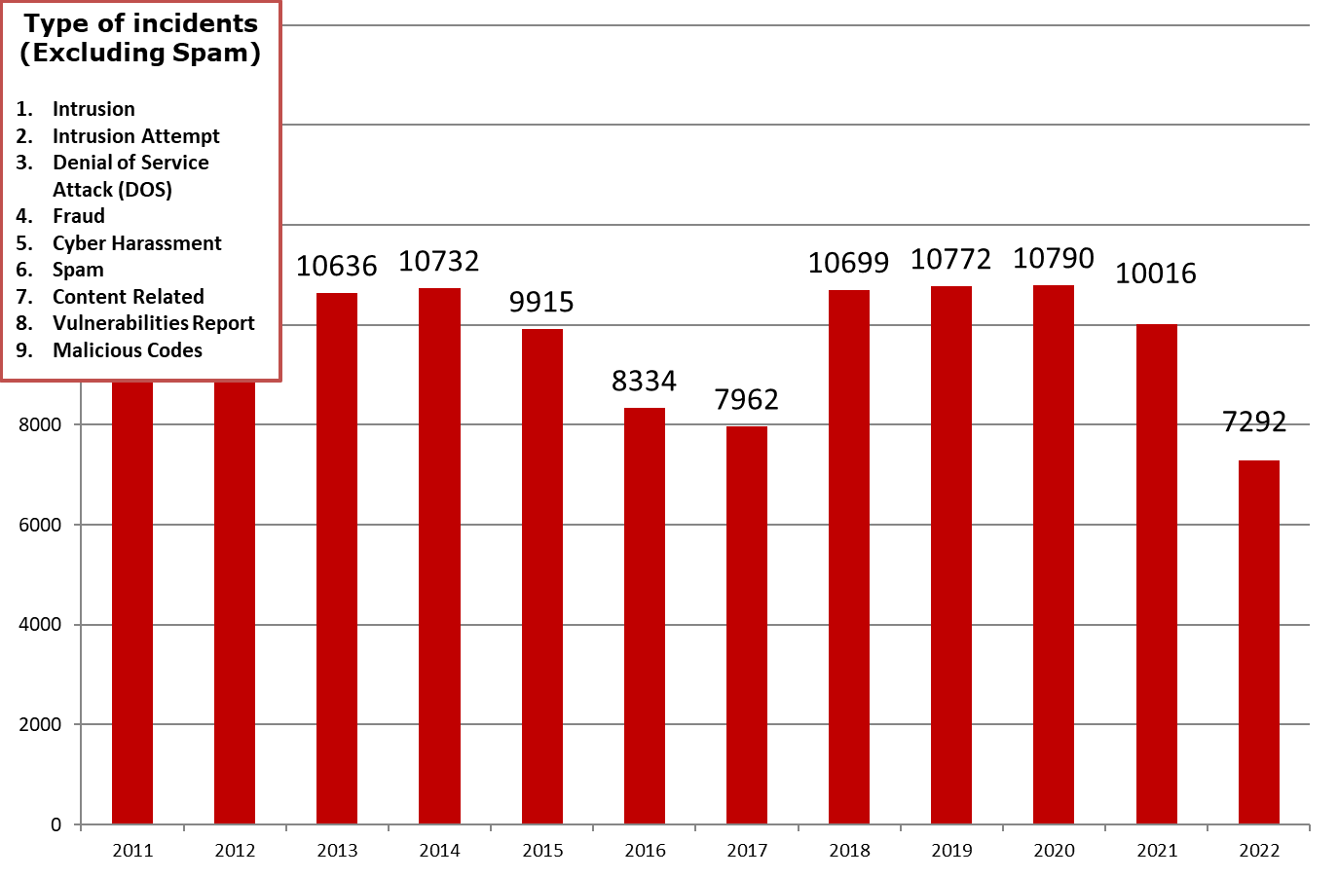
CYBER INCIDENTS REFERRED TO CYBERSECURITY MALAYSIA
(2011 – 31 December 2022)
TOP FOUR CYBER INCIDENTS IN MALAYSIA (CYBER999)
Fraud
Malicious Code
Intrusion
Content Related
Types of incidents
Intrusion
Intrusion Attempt
Denial of Service Attack (DOS)
Fraud
Spam
Content Related
Vulnerabilities Report
Malicious Codes

Slide 12
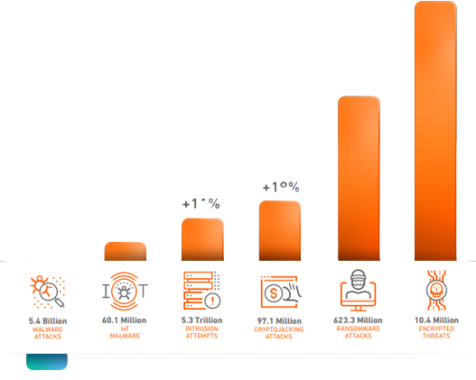
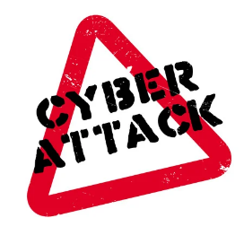

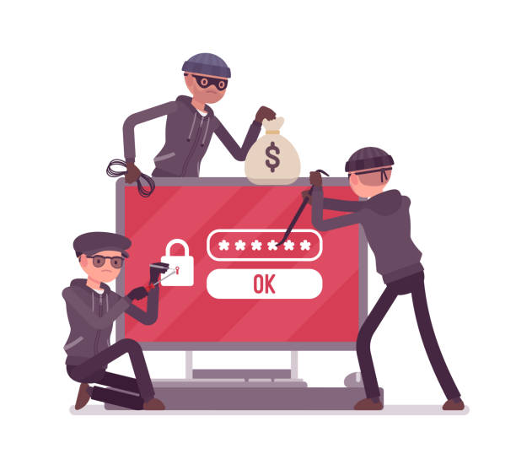
2022 GLOBAL
CYBER-ATTACK TRENDS
+167%
+105%
+19%
+11%
+6%
-4%
5.4 Billion
60.1 Billion
5.3 Trillion
97.1 Million
623.3 Million
10.4 Million
MALWARE ATTACKS
IoT
MALWARE
INTRUSION
ATTEMPTS
CRYPTOJACKING
ATTACKS
RANSOMWARE
ATTACKS
ENCRYPTED
THREATS
2022 SonicWall Cyber Threat Report (infopoint-security.de)

Slide 13

HOW TO ANALYSE
INCIDENT RESPOND EFFECTIVELY
?

Slide 14




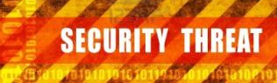




CSM
RESPONSIVE CYBER SECURITY SERVICES
Cyber999 Help Centre
Cyber Early Warning
Cyber Threat Research Centre (CTRC)
Coordinated Malware Eradication & Remediation Project (CMERP)
Technical Coordination Centre
Computer Security Incident Response Team (CSIRT) Consultancy
MASSA
Lebahnet (Honeynet Project)
Malware Research Center

Slide 15
Effectiveness of Incident Response can be analyzed by:
The structuredness of the incident response operation. For example, the setup or design of the incident response team - a hierarchy level with a number of Tiers (Tier 1, Tier 2, Tier 3) or is it just a single Level? A hierarchy-based incident response in general indicates an effective team.
Number of reported incidents from the constituency (trending from past incidents can be a benchmark). What could be the reason if there is a drop in number of reported incidents. Public lost confidence in reporting incident? Other reasons?
Speed of initial response (SLA) to incidents responded at First Level Support. Is there an SLA? If yes, is it complied?
Ability to mitigate and remove potential threats from compromised system. Is the team capable with enough resources?
Ability to communicate incidents (especially high-profile incidents) to stakeholders, in timely manner

Slide 16
Effectiveness of Incident Response can be analyzed by:
Ability to cooperate with other CSIRT teams in support of investigations and prosecutions. How many CSIRTs the team cooperate or collaborate with? Is there any special technical mutual collaboration?
Number of incidents that were managed (closed successful or unsuccessful) in accordance with established SOP and SLA
Appropriate reporting channels for organisations and the general public to report incidents, from anywhere and at any time, such a hotline number and 24x7 On-call Reporting. Number of channels? Is it reachable to the public and organisations?
Staff specialisation is specific areas in incident response, i.e. malware analysis, threat intelligence, intrusion detection
Readiness and preparedness level in handling incidents. Is there a periodic exercise to test the readiness or preparedness?

Slide 17

What could have been done better?
Agile Incident Response
Quickly identify, contain and remediate incidents, reducing the risk of damage and improving overall security
A Well-defined Incident Response Standard Operating Procedure (SOP)
The SOP should have been established in a systematic way and more structured. It should be assessed, reviewed, tested and validated by Experts in the field. This is to ensure that responses are carried out in a consistent, systematic and effective manner.
Conduct A Periodic And Consistent Review Of The Effectiveness Of The Incident Response
This should be defined in the incident response SOP. This includes speaking to respective parties involved in an incident and getting their feedback on how they perceived the effectiveness of the incident response team in handling incidents. An incident has occurred, a review should be conducted to assess the effectiveness of the response. This can be done through online feedback forms and surveys.

Slide 18

What could have been done better?
Establishing A Coordination Centre For Incident Response In The Constituency
Incidents can be coordinated among different agencies for consistency and more effective incident response
Evaluate The Remediations And Mitigations In Containing And Eradicating Incidents
This is important in preventing further spreads of incidents, re-occurrence of incidents and restoring normal operations.
Evaluate Response Time And Communication
The initial response time and communicating an incident precisely and accurately between involved parties can have huge impact the outcome of an incident.
This is crucial to identify issues with resources or processes and communication barriers for improvement.

Slide 19



What could have been done better?
Communicate And Share Threat Information More Often With Other Security Players, Globally, with Other National CSIRTs.
Participate more on information sharing and other initiatives with global security communities in tackling cyber threats and measures to mitigate and resolve incidents.
Train Staff to be experts in their relevant field related to cybersecurity, focus on specialization.
Regularly Assess the effectiveness of incident response plan and procedures, identify areas for improvement, and make updates as necessary.
Tools: Ensure that staff have access to the latest resources and tools needed to effectively respond to incidents.

Slide 20

CYBERSECURITY MEASURES

Slide 21

CYBERSECURITY MEASURES FOR ORGANISATIONS
Defence-in-depth
Zero trust approach.
Firewall, anti-malware software and patch management.
Proper cybersecurity awareness and training.
Multi-factor authentication and limit password reuse.
Implementing good security policy.
Have a Bring Your Own Device (BYOD) policy
Regularly back up all data.
This Photo by Unknown author is licensed under CC BY-SA-NC.

Slide 22
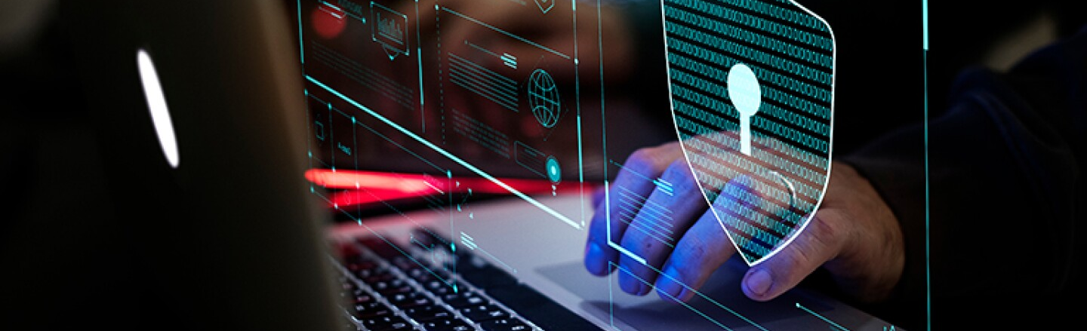
PROTECTING FROM EVOLVING CYBER THREATS
Keep your cybersecurity systems updated with all the necessary SOPs active
Use modern and security-rich network infrastructures by trusted manufacturers
Make sure your IT team is leveraging the latest threat intelligence methodologies to monitor malicious activities
You must onboard the right talent and cybersecurity tools to address the evolving cybersecurity threats
Outsource an experienced cybersecurity firm to deal with cyber threats effectively

Slide 23
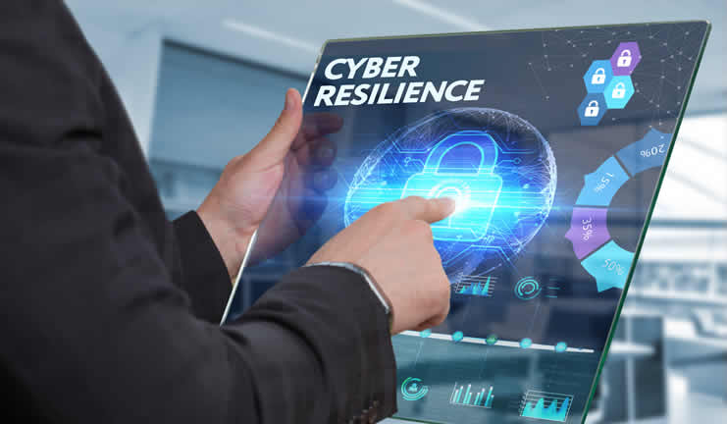
CYBER RESILIENCE
Is the ability to anticipate, withstand, recover from, and adapt to adverse conditions, stresses, attacks, or compromises on systems that use or are enabled by cyber resources regardless of the source
Adopting cyber security approach is a must, however, being resilient is the way forward…

Slide 24

Cyber Resilience – so much more than Cybersecurity
No matter how secure is an organization, there is no such thing as 100% secure.
It is no longer the question of how to secure oneself from being attack.
It’s just a matter of time that a cyber-attack can occur to an organization.
Hence, what is more important is that the organisation try their best to strategize in order to lessen the impact due to cyber-attacks. It is crucial to know how to act and recover or bounce back once being attacked.

Slide 25
CYBERSECURITY VS CYBER RESILIENCE
CYBERSECURITY | CYBER RESILIENCE
Definition: procedures followed, or measures taken to ensure the safety of a state or organisation | Definition: the capacity to recover quickly from difficulties; toughness
Technologies and processes are designed to protect an organisation from cybercrime | Technologies and processes designed to keep delivering intended services in spite of cyber incidents
Works to reduce the risk of cyber-attacks and to protect the organisation from cyber theft/ espionage | Works to ensure continuity on a wider scope, comprising cybersecurity and business requirements
Can work effectively without compromising the usability of other systems | Requires organisation-wide culture shift that normalises and embeds security best practices
Includes a business plan to resume operation in the event of a successful attack | Requires the organisation to become agile and adaptable in the face of cyber-attacks and incidents
Action/plan/program in reducing risk and implementing
security approach
Action/plan/program upon occurred incidents and what to do next

Slide 26
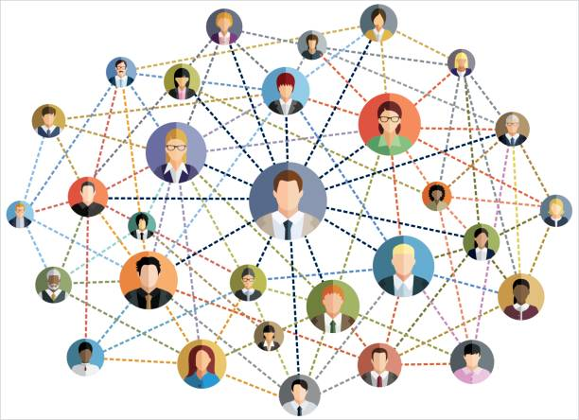
EVERYBODY IS RESPONSIBLE
CYBERSECURITY DOES NOT OPERATE IN SILO!
THE MANAGEMENT MUST SHOW THE EXAMPLE, BY LEADING
THE ORGANISATION IN ENHANCING CYBERSECURITY

Slide 27
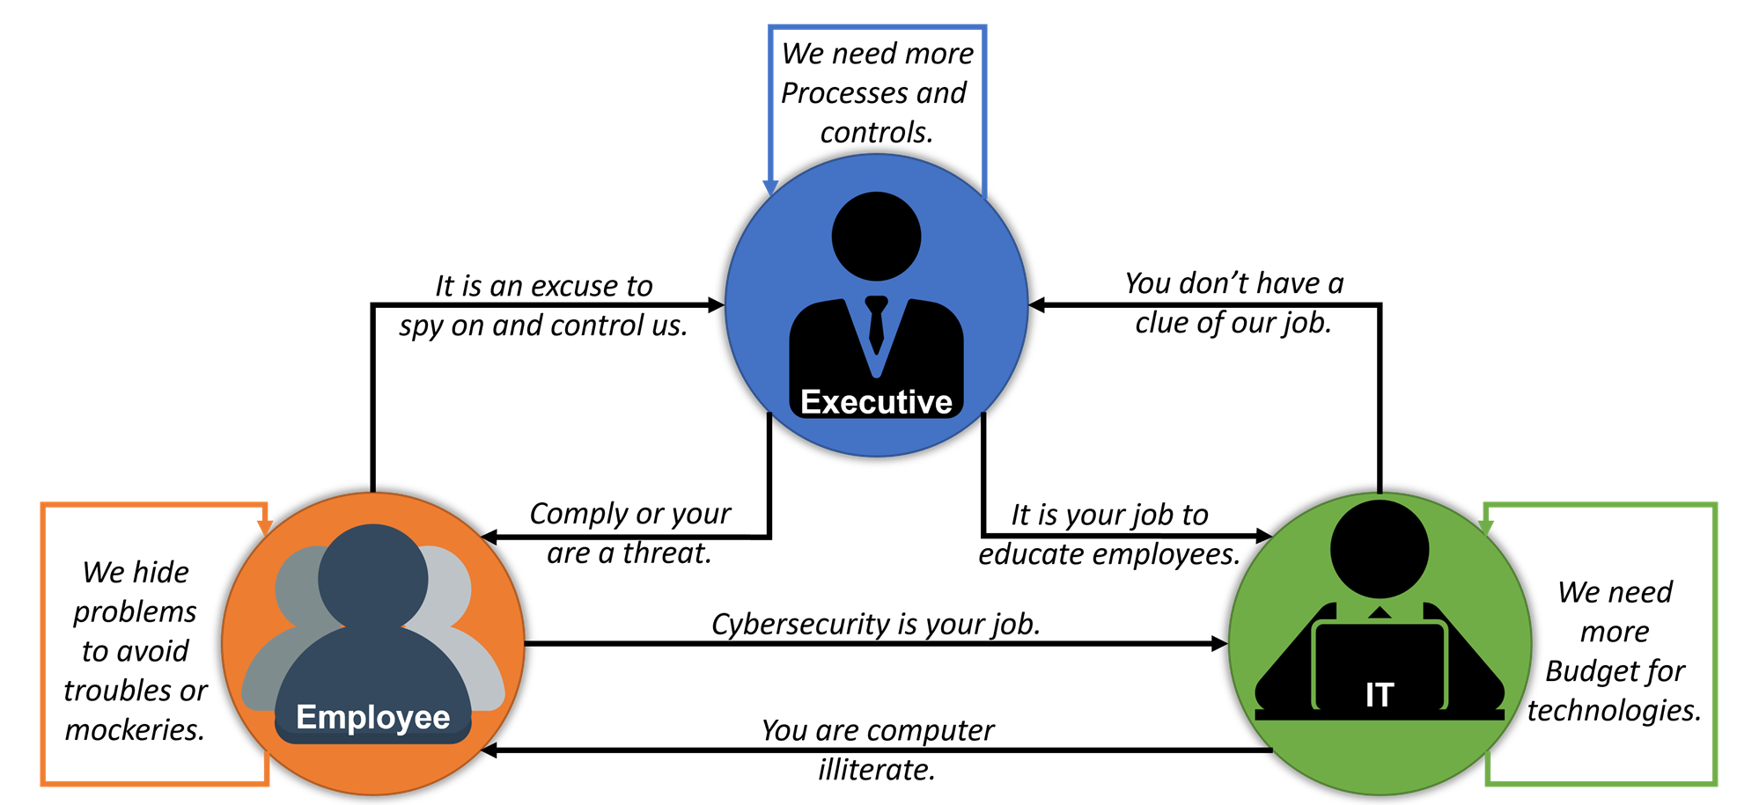
CYBERSECURITY:
A SHARED RESPONSIBILITY

Slide 28
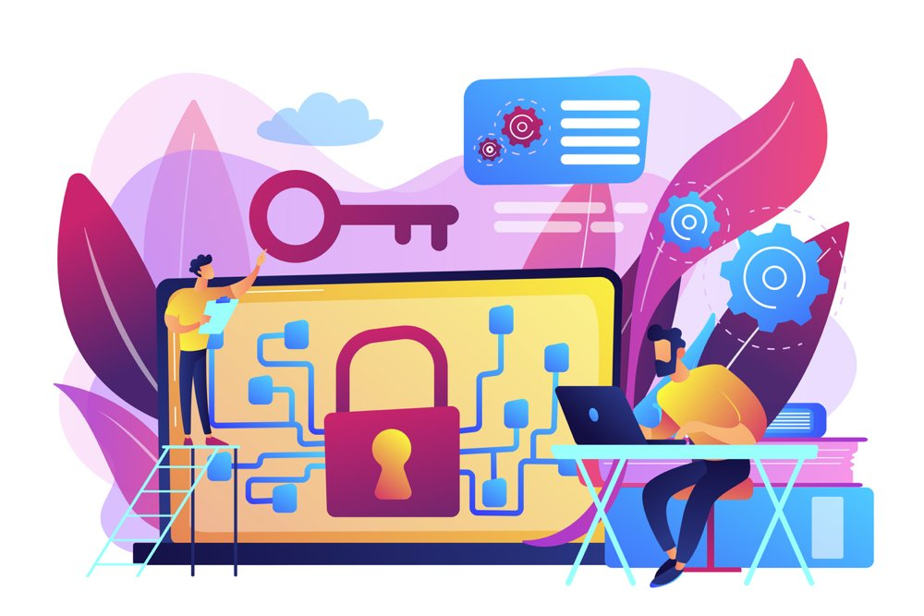
HOW TO CREATE A CYBERSECURITY CULTURE?
Start with the C-Level and make security relevant
Make your program human-centric
Make security awareness training fun and rewarding
Invest in the right security tools and provide security talents
Have a CISO succession plan in place
https://www.techtarget.com/searchcio/tip/Cybersecurity-teamwork-C-suite-roles-CIOs-should-befriend
Notes:
https://www.techtarget.com/searchcio/tip/Cybersecurity-teamwork-C-suite-roles-CIOs-should-befriend

Slide 29




HOW TO PREVENT HUMAN ERRORS?
UPDATE SECURITY POLICY
EDUCATE EMPLOYEES
Clearly outline how to handle data and passwords, best practices, and suitable monitoring software to use
(e.g. ISMS polices)
Ensuring each employees are well trained, educated, and aware of the latest cybersecurity practices
ENFORCE THE PRINCIPLES OF LEAST PRIVILEGE
MONITOR EMPLOYEE ACTIVITY
To detect malicious activity and secure user system from data leak and cyber attack
A subject should be given only those privileges needed for it to complete its task. If a subject does not need the right to an access, the subject should not have that right
https://www.ekransystem.com/en/blog/how-prevent-human-error-top-5-employee-cyber-security-mistakes

Slide 30

CyberSecurity Malaysia's
Initiatives

Slide 31







Adoption of holistic approach that identifies potential threats to organization and impacts to the national security & public well-being ; and
To develop the nation to become cyber resilience having the capability to safeguard the interests of its stakeholders, reputation, brand and value creating activities.

Slide 32
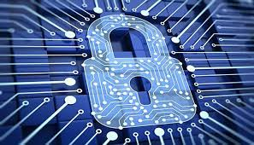
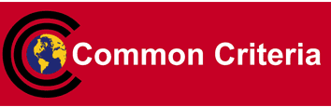
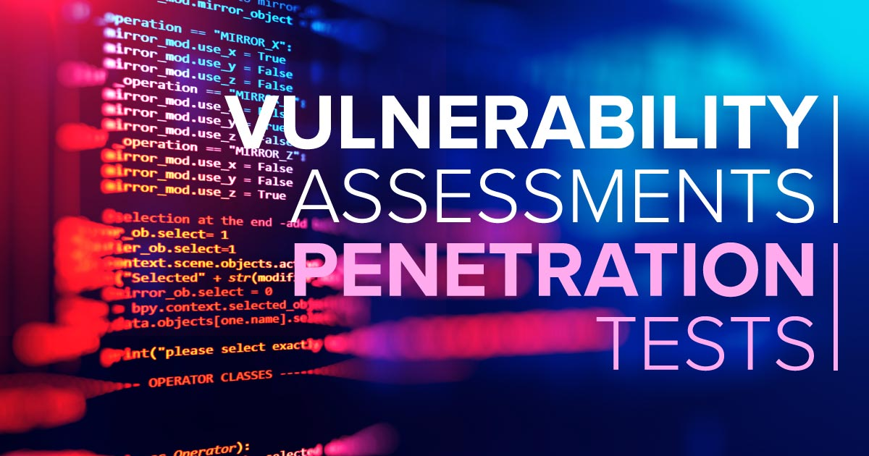
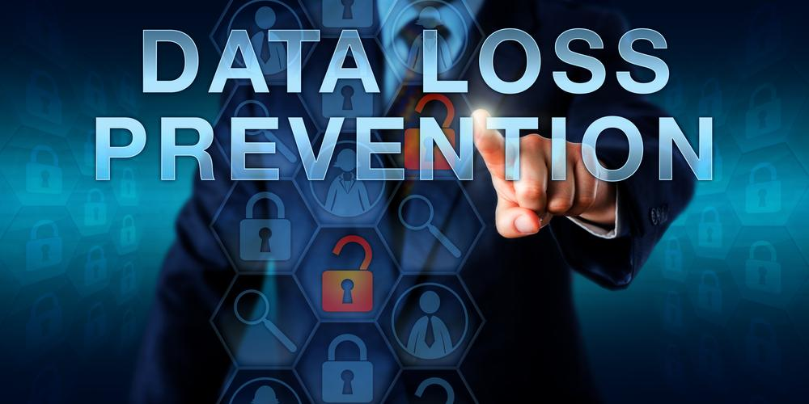



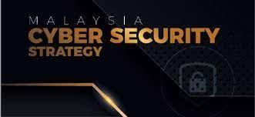


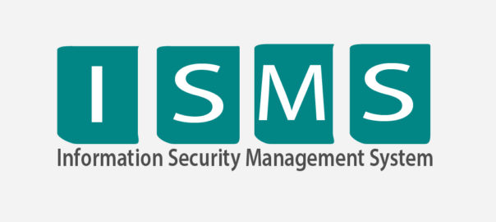

SIBERKASA
DEFENSE IN DEPTH
Product security and ICT systems guarantee
Technology
People
Process

Slide 33
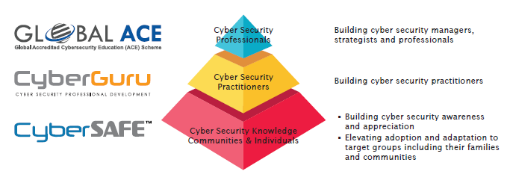
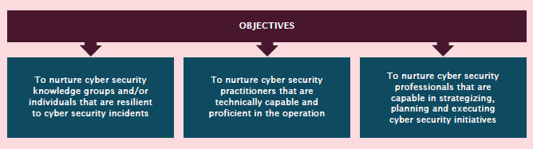
CYBERSECURITY CAPACITY BUILDING FRAMEWORK
Global ACE Scheme
https://www.cybereducationscheme.org
Cyberguru
https://www.cyberguru.my
Cybersafe
https://www.cybersafe.my

Slide 34

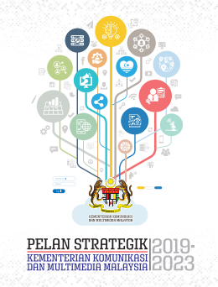


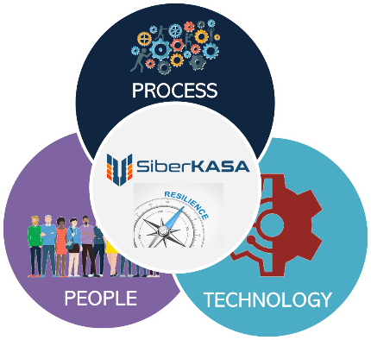



KKMM Strategic Framework
Twelfth Malaysia Plan (RMK-12)
Strategic Thrust 2:
Driving the Digital Economy and IT Towards Developed Countries
Strategic Thrust 3:
Strengthen the regulation of a reliable and stable communications and multimedia ecosystem
Pillar 1: Source of Growth
Pillar 4: Human Capital Transformation and Market Strengthening Labor:
Pillar 5: Inclusivity and People’s Well being
Pillar 6: Institutional Reform
Pillar 7: Social Capital
CSM’s Role in Supporting National Cybersecurity Related Policies & Strategic Plans
National Technical Cybersecurity Agency responsible to advice & implement cybersecurity related programs
Malaysia Digital Economy Blueprint
Malaysia
Cyber Security Strategy
Pillar 1: Effective Governance and Management
Pillar 2: Strengthening Legislative Framework and Enforcement
Pillar 3: Catalysing World Class Innovation, Technology, R&D and Industry
Pillar 4: Enhancing Capacity and Capability Building, Awareness and Education
Pillar 5: Strengthening Global Collaboration
National 4th Industrial Revolution Policy (N4IR)
Thrust 1: Drive digital transformation in the public sector
Thrust 4: Build agile and competent digital talent
Thrust 6: Build trusted, secure and ethical digital environment
Thrust 1:
Equip the Rakyat with 4IR knowledge and skill sets
Thrust 3:
Future-proof regulations to be agile with technological changes
Notes:
SiberKASA adalah sejajar dan menyokong hasrat Kerajaan sepertimana yang dinyatakan di dalam pelbagai dasar dan polisi strategik iaitu Wawasan Kemakmuran Bersama 2030, Kerangka Strategik KKMM, Rancangan Malaysia Kedua Belas (RMKe-12), Rangka Tindakan (Blueprint) Ekonomi Digital Malaysia (MyDIGITAL), Strategi Keselamatan Siber Malaysia (MCSS), dan Dasar Revolusi Perindustrian Keempat Negara (4IR).
CyberSecurity Malaysia bertindak sebagai agensi Agensi Teknikal Keselamatan Siber Negara (National Technical Cybersecurity Agency) yang bertanggungjawab dalam memberi input strategik dan melaksana (advice and implement) pelbagai program berkaitan keselamatan siber agar ia menjadi bidang tumpuan utama kerajaan yang harus diberi perhatian wajar oleh semua pihak bagi membanteras ancaman dan jenayah siber.
Melalui SiberKASA, CyberSecurity Malaysia juga bertindak dan memainkan peranan penting kerana bidang keselamatan siber adalah menjadi pemboleh utama (key enabler) di dalam menangani insiden keselamatan siber yang semakin kompleks dan memerlukan pendekatan yang berbeza apabila dunia menuju transformasi pendigitalan ekonomi dan teknologi Revolusi Industri 4.0.

Slide 35
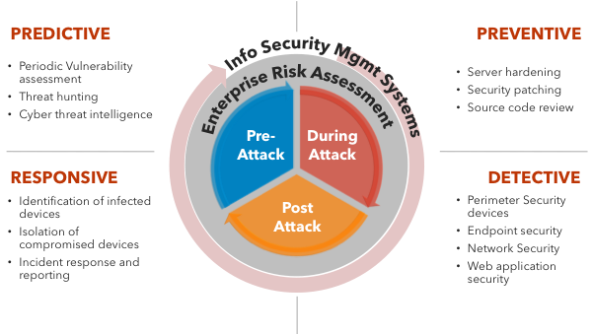

ADDRESSING CYBER RESILIENCY THROUGH ADAPTIVE SECURITY
To be more proactive, dynamic and integrated in cybersecurity approach
Adaptive Security is an approach to cybersecurity that analyzes behaviors and events to protect against and adapt to threats before they happen. With an Adaptive Security Architecture, an organization can continuously assess risk and automatically provide proportional enforcement that can be dialed up or down
The cost to organizations comes at each stage of the incident response lifecycle — detection, notification, responses, post-incidents, and the cost of business losses.

Slide 36






(Program PemerKASAan Keselamatan Siber)
Objective: Empowering, strengthening and preserving the cyber security infrastructure and ecosystem in Malaysia so that it is always sustainable, protected and resilient.
HUMAN
PROCESS
TECHNOLOGY
Covers aspects of skills, knowledge, ethics, behavior and talent
Covers aspects of policy development, strategy, Standard Operating Procedure (SOP), recognition of international standards
Involves technology in particular matters related to minimizing vulnerabilities, digital forensic analysis, malicious code (malware) and data
PRODUCT
PRODUCTS AND SERVICES
Global Accredited Cybersecurity Education (ACE)Scheme
CyberSAFE L.I.V.E Gallery
Cybersecurity Competency Training (CyberGuru)
Crypto Random Test Tool X-Forensics Tools PenDua Tool | Coordinated Malware, Eradication, and Remediation Platform (CMERP) LebahNet CamMuka (Facial Recognition)
Business Continuity Management System (BCMS) Certification Digital Forensics (DF) Case Management Incident Handling Case Management Cyber Discovery MyTrustSEAL Penetration Testing Service Provider(PTSP) Certification | Technology Security Assurance (TSA) ICT Product Security Assessment (IPSA) Security Posture Assessment (SPA) SCADA Security Assessment (SSA) PHP Secure Code Assessment (PSCA) Malaysian Common Criteria Scheme (MyCC) Cybersecurity Strategic and Technical Advisory
MyCyberSecurity Clinic (MyCSC)- Data Recovery and Data Sanitization Services Lab Quality Management Cybersecurity Lab Services CyberSecurity Malaysia Cryptographic Evaluation Lab (MyCEL) CCTV Forensics Service | Cyber Threat Intelligence Service Cloud Security Compliance Audit Cloud Security Assessment Audit Cloud Security Audit for ISMS Security Operation Centre Service Red Teaming Service
SERVICE

Slide 37

CONCLUSION AND WAY FORWARD
There is no such thing as 100% security. There is still much improvement to be made. We need to increase and strengthen our cybersecurity manpower and professional skills.
There is a need to ensure for a secure, resilient and trusted cyber environment in order to sustain progression and prosperity. In this regard, a more innovative and proactive adaptive security approach is required to address such situations. Adaptive cybersecurity encompasses predictive, detective, responsive and corrective capabilities.
In addition, our approach also has to be adaptive, dynamic and innovative covering people, process and technology.
Strengthening Public-Private-Academia Partnership and national, bilateral, regional and International Collaboration.
Malaysia should gear itself towards cyber resilience as the threat of a global cybersecurity breach continues to pose a major risk.

