Slide 1
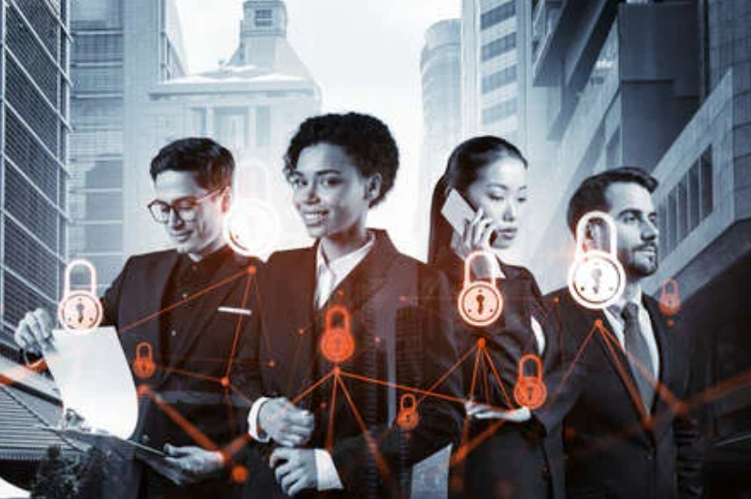
Humanizing Information Security
For A Connected World
Presenter:
Head, Information Security
MCIIS FBCS CITP CCISO MBA
CISM CDPSE CME CBA PCI-ISA
Email: shangyee.toh@mcis.my
LinkedIn: https://www.linkedin.com/in/tohshangyee
MCIS Insurance Berhad
(Member of Sanlam Group)

Slide 2
A quick introduction

Slide 3
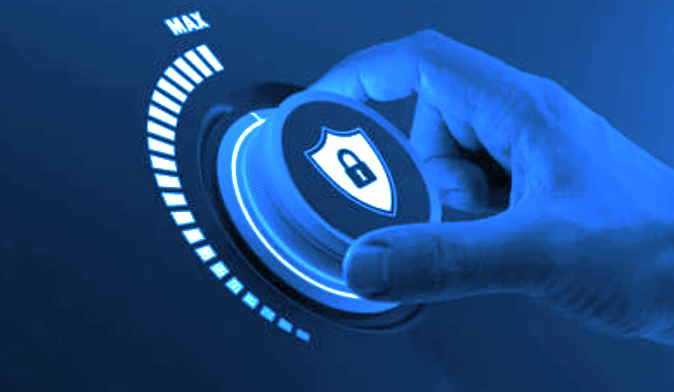
What we have done well in cyber resilience so far?
Governance
Resilience
Securing
Vigilance

Slide 4
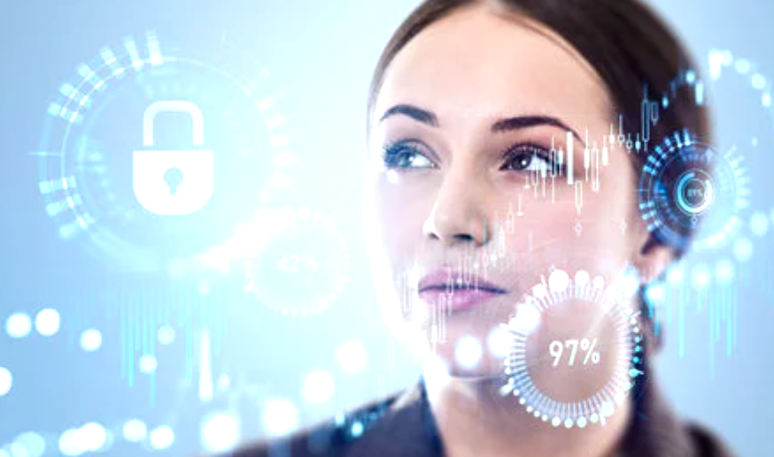
But we still having following trends…
A cyber attack at the rate of seconds
Global cost of cyber compromise of US$10.5 trillion by year 2025
15% annual growth of cyber events
A data breach costs at US$4 million averagely
Younger generation getting interested to hack

Slide 5

Qualifying human as major links to cyber weaknesses
Human created amazing things for the best of human kind,
BUT WE HAVE BEEN
Considering smaller factor of vulnerabilities
Overlooking human bad habits
Thought cyber attacks could be complex
Never mind, we can wait for the fix to come. The attack will not hit us so fast.

Slide 6
Some common human errors of opportunities to cyber threats
Do not jog down the password on sticky notes but use the same password everywhere
Post and share a lot of things online
Use publicly suggested tools with no question ask
We trust this access as it is already authenticated earlier
This unusual thing is too small for me to report
Bypass technology and security department as their response time is just too slow
Etc

Slide 7
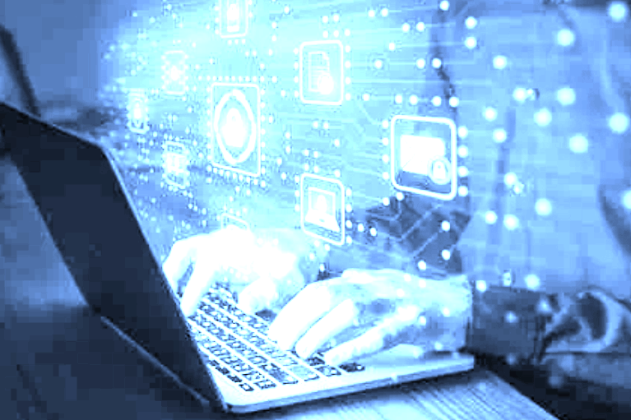
Human does act a lot of cyber weaknesses
as technologies itself will not smart enough to do the same

Slide 8

Promising financial gain, laundering
and skipping payments
Compromising vulnerabilities of digitization
Hack for illegal money gain
Manipulate financial commitments

Slide 9
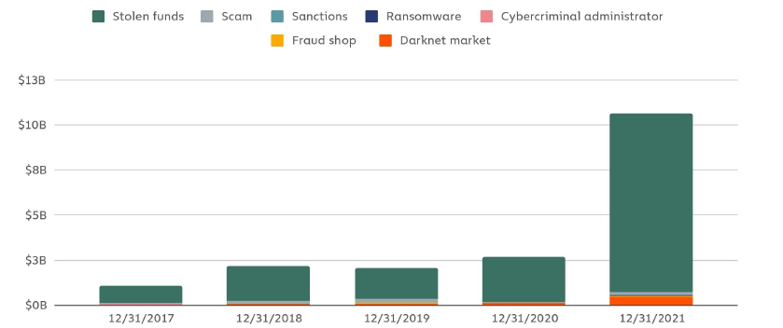
Year End Criminal Balances 2017-2021
(Source: The 2022 Crypto Crime Report, Chainalysis)

Slide 10

Being curious and adventurous to cyberspace with free flow of information
Infinity of the virtual world
Limitations of physical space
Information becomes freely, increasingly valued and realistically not easy to control

Slide 11

Demonstrating capabilities
in technical challenges
Rise of excitement and psychic satisfaction to break stronger security
Manifested into more than younger minds
Not limited to technical skills but transforming unique individual exposures

Slide 12

Getting out of envy, hatred and evidence
through opportunities of cyber weaknesses
Dissatisfied employees and citizens enter into emotional attempts
Committing damages to public assets and critical
infrastructure turns to motivations
Degradation of public care and empathy

Slide 13
Anti deviance used for success in business and political space
Cyber technologies enable enhancement of target audience's confidence
Era of brand damages of competitors
Possible victimizing other enterprises for winning the market shares

Slide 14
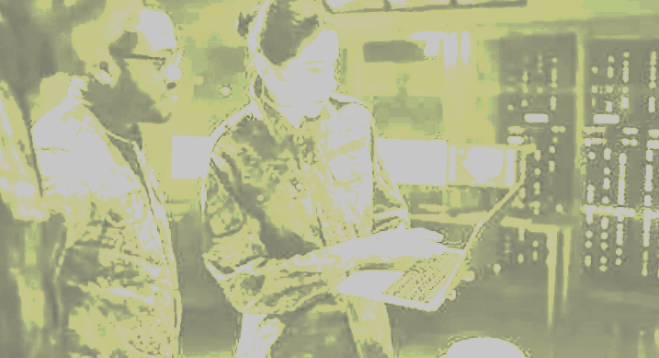
Weaponization of emerging technology
and Cyberwarfare becomes the strength of a country
Technology leveraged and weaponized for differentiating capabilities for countries to sustain and be future proof from others
Human to lead next effective ways for resolving International conflicts

Slide 15

Change and complication of ethical values
in cyber world
Conduct of life through moral values carrying out society ethical decisions has evolved
Concepts of privacy and transparency greatly changed
Next metaverse may new opportunities of cyber threats

Slide 16

We will need
a better cybersecurity mind paradigm

Slide 17
Cyber threats will continue to advance
Everyone are challenged to be fully preventive
Rather reducing the possibilities
and quantifications of impacts
Continuous strengths in positive mental power
Understand hacker's mind to protect our crown jewels

Slide 18

What can be suggested to improve?
Human weaknesses and security habits monitoring and improvement program
Modernised cybersecurity awareness to every human factor in your business
Developing human capital as your enterprise security network
Enable your human capital to contribute security as key responsibilities and values

Slide 19
We concluded human links as a key factor to cyber risks.
It is crucial in
Addressing the most critical factor to cyber risk – the people, and recognising their vulnerabilities
Understanding the implication of human factor on cybersecurity and ways threat actor penetrate the system
Educating workforce on the business value of cyber resiliency and their role in it

Slide 20

Questions and Answers
Thank you.
Presenter:
Toh Shang Yee
Head, Information Security
MCIIS FBCS CITP CCISO MBA
CISM CDPSE CME CBA PCI-ISA
Email: shangyee.toh@mcis.my
LinkedIn: https://www.linkedin.com/in/tohshangyee
MCIS Insurance Berhad
(Member of Sanlam Group)

