Slide 1
Improving Cyber Hygiene in the Organization

Slide 2
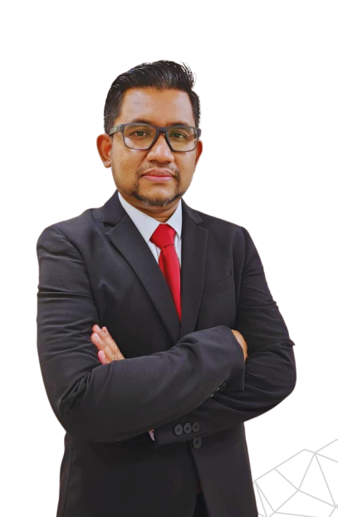
About Me
Hibatul Hakimi Bin Zainul Abidin (Kimi)
AVP, IT & Cybersecurity, Cagamas Berhad
14 years of experience in Information Security, IT Security & IT Audit in a wide span of industries including National Cybersecurity Agency, Oil & Gas, Telco, Aviation & Financial Industry
https://www.linkedin.com/in/hibatul-hakimi-z-79688642/

Slide 3
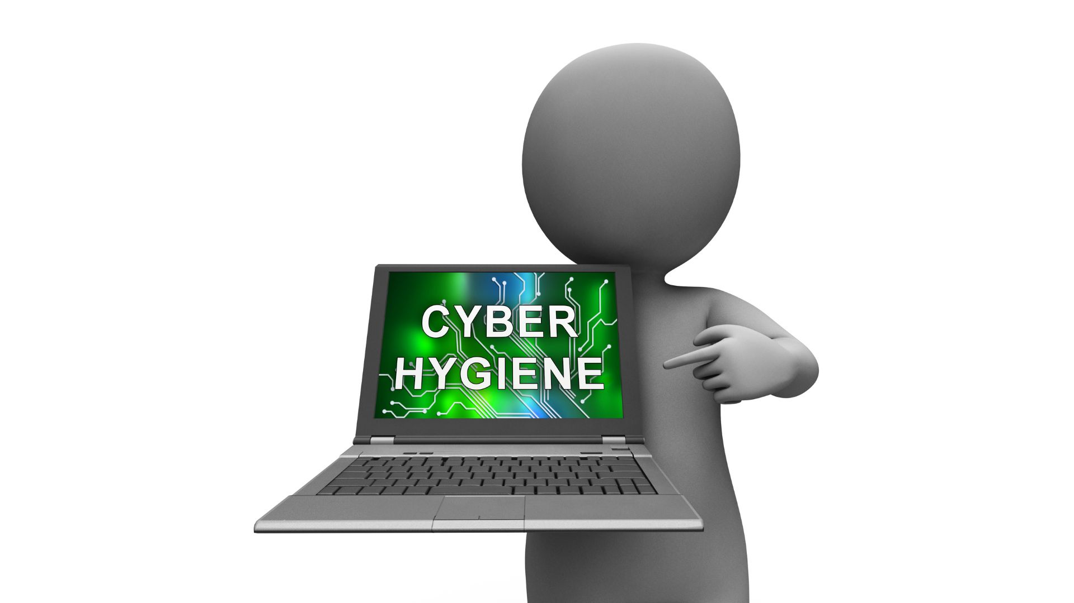
Outline
Data breaches and common causes
What is cyber hygiene
What are the benefits and challenges of practicing cyber hygiene
Cyber hygiene program in Cagamas
Essential cyber hygiene with Center for Internet (CIS) Control
Conclusion

Slide 4
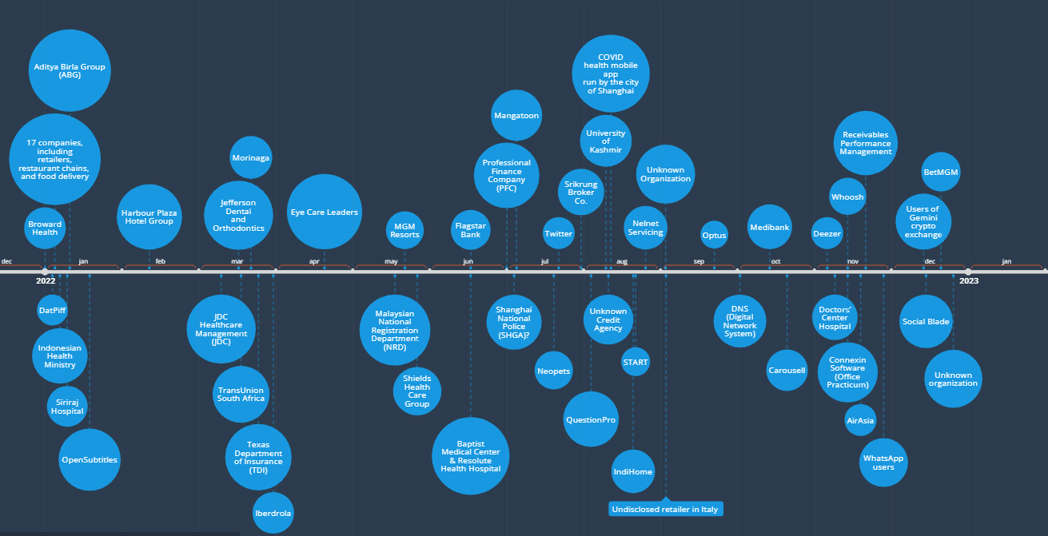
The Biggest Data Breaches 2022
Source: https://www.hackmageddon.com/2022/01/27/the-biggest-data-breaches-of-2022/

Slide 5
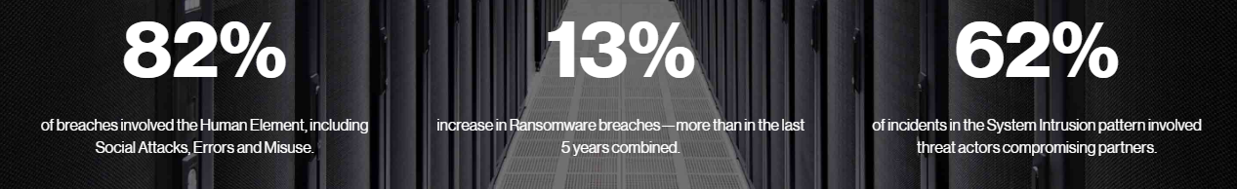
Common Causes of Data Breach
Source: https://www.verizon.com/business/resources/reports/dbir/#resources
Old, unpatched security vulnerability
Human Error
Malware
Insider Misuse
Physical Theft of a Data Carrying Device

Slide 6
About cyber hygiene
Cyber hygiene refers to the collection of regular best practices that an organization undertakes that maintain system health and improve cybersecurity. The term cyber hygiene was coined by Vinton Cerf, an Internet pioneer, who used that the expression in his statement to the United States Congress Joint Economic Committee on 23 February 2000:
“It is my judgment that the Internet itself is for the most part secure, though there are steps we know can be taken to improve security and resilience. Most of the vulnerabilities arise from those who use the Internet--companies, governments, academic institutions, and individuals alike--but who do not practice what I refer to as good cyber hygiene. They are not sufficiently sensitive to the need to protect the security of the Internet community of which they are a part. The openness of the Internet is both its blessing and its curse when it comes to security.”
The European Union's Agency for Network and Information Security (ENISA) states that "cyber hygiene should be viewed in the same manner as personal hygiene and, once properly integrated into an organization will be simple daily routines, good behaviors, and occasional checkups to make sure the organization's online health is in optimum condition".

Slide 7
Cyber hygiene practices – a standard approach
Various nations have their own recommendations and advisories to indicate what should be considered general good cybersecurity practice, such as the NIST Guides for US, Cyber Essentials for UK, Money Authority of Singapore (MAS) Cyber Hygiene Notice for Singapore Financial Institution, etc. In addition, there are various best practice frameworks are available like Center for Internet Security (CIS) Critical Security Controls and ISO27001 which can be used but there is no single standard or commonly agreed-upon mechanism for an organization to assess, evaluate, or demonstrate cyber hygiene.
NIST
Network Protection
People Protection
Cyber Essentials
Firewall
Secure configuration
MAS
Securing administrative accounts
Establishing written security standards
Endpoint Protection
Facility Protection
Secure update management
User access control
Malware Protection
Applying security patching
Network Perimeter defence
Implementing anti-malware measures
Implementing Multi-factor Authentication

Slide 8


Cyber Hygiene Benefits & Challenges
Benefits
Increased Security
Challenges
Resistance to Change
Strong Reputation
Compliance
Improve Employee Awareness
Reduce Costs
Better Risk Management
Lack of Resources
Difficulty Keeping Policies Up to Date
Enforcing Cyber Hygiene Policies
Difficulty Measuring Success

Slide 9
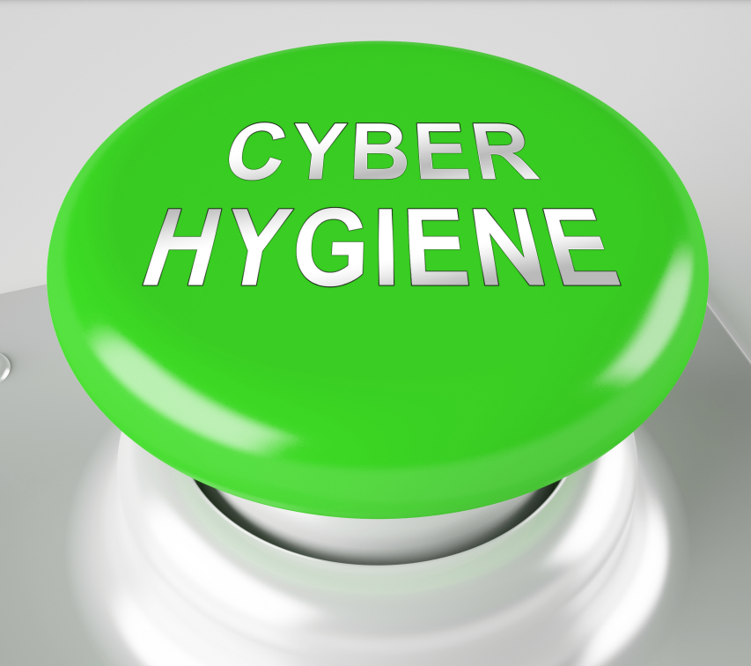
Cyber hygiene Programme in Cagamas
Cybersecurity optimization initiative is a part of the cybersecurity strategy under the 5 years Digital Strategy 2022-2027 by conducting review of existing cyber security controls in place to fine-tuning cybersecurity defenses to protect the crown jewels of the Company.
The Center for Internet Security (CIS) Top 18 Critical Security Controls is chosen as the guideline since it is by far the easiest to understand and use.
CIS created 3 Implementation Groups (IG1-IG3) to simplify and prioritize the process of effectively implementing the CIS Controls. IG1 is an essential cyber hygiene and represents an emerging minimum standard of information security for all enterprises. In most cases, an IG1 enterprise is typically small to medium-sized with limited IT and cybersecurity expertise to dedicate towards protecting IT assets and personnel.
IG1 is the on-ramp to the CIS Controls and consists of a foundational set of 56 cyber defense safeguards. The Safeguards (SG) included in IG1 are what every enterprise should apply to defend against the most common attacks.

Slide 10

Essential Cyber Hygiene with CIS Controls
01-Inventory & Control of Enterprise Assets
04-Secure Configuration of Enterprise Assets & Software
05-Account Management
06 –Access Control Management
07-Continuous Vulnerability Management
08-Audit Log Management
09-Email and Web Browser Protections
02-Inventory and Control of Software Assets
03-Data Protection
12 –Network Infrastructure Management
10-Malware Defenses
11-Data Recovery
17-Incident Response Management
13-Network Monitoring and Defense
14-Security Awareness and Skills Training
15-Service Provider Management
16-Application Software Security
18-Penetration Testing

Slide 11
CIS 1&2 :Inventory & Control of Enterprise & Software Assets
Organization cannot defend what they do not know they have. Managed control of all enterprise assets also plays a critical role in security monitoring, incident response, system backup, and recovery.
A complete software inventory is a critical foundation for preventing attacks. Attackers continuously scan target organizations looking for vulnerable versions of software that can be remotely exploited.
Enterprise Asset
SG1: Establish and maintain a comprehensive enterprise asset inventory
SG2: Address unauthorized assets
Software Asset
SG1: Establish and maintain an up to-date software inventory
SG2: Ensure authorized software is currently supported
SG3: Address unauthorized software

Slide 12
CIS 7:Continuous Vulnerability Management
Focuses on identifying, prioritizing, documenting and correcting vulnerabilities in an IT environment.
Organizations that do not assess their infrastructure for vulnerabilities and proactively address discovered flaws face a significant likelihood of having their enterprise assets compromised.
SG7.1: Establish and maintain a vulnerability management process
Organizations need to decide how they will identify, evaluate, remediate and report on possible security vulnerabilities
SG7.2: Establish and maintain a remediation process
Organizations need to decide how they will respond to an identified vulnerability
SG7.3: Perform automated operating system patch management
It is important to keep all operating systems patched in a timely manner
SG7.4: Perform automated application patch management
Keeping applications patches is just as important as patching operating systems

Slide 13








CIS 14: Security Awareness & Skills Training
Week 1: Week of 3rd Oct
Cyber Drill Exercise*
Week 2: Week of 10th Oct
Cybersecurity Awareness Training (external Speaker) – virtual
Week 3: Week of 17th Oct
Information Security Management System (ISMS) Awareness Training (External Speaker) – Virtual*
Week 4: Week of 24th Oct
Cybersecurity Poster Contest
Cybersecurity E-Learning (LinkedIn)
Cybersecurity Quizzes
Senior Management Visit to Cybersecurity Malaysia Office*
Cyber Risk in ESG Awareness Talk (External Speaker) – Virtual*
Cybersecurity Chit Chat-Coffee Talk (Internal) – In-person
SG14.1:Establish and maintain a security awareness program
SG14.2:Train workforce members to recognize social engineering attacks
SG14.3:Train workforce members on authentication best practices.
SG14.4:Train workforce on data handling best practices.
SG14.5:Train workforce members on causes of unintentional data exposure.
SG14.6:Train workforce members to recognize and report potential security incidents.
SG14.7:Train your workforce on how to identify and report if their enterprise assets are missing software patches and security updates.
SG14.8:Train your workforce on the dangers of connecting to and transmitting data over insecure networks.

Slide 14
CIS 17: Incident Response Management
SG17.1: Designate personnel to manage incident handling
SG17.2:Establish and maintain contact information for reporting security incidents
SG17.3:Establish and maintain an enterprise process for reporting incidents
Incident Response
Advisories and Alerts
E-Discovery & Digital Forensics
Security Awareness
Primary function of CagaCERT. It involves receiving, triaging, investigating and responding to reported security incidents.
Timely information about current security issues, vulnerabilities, exploits and advisories of new attacks or vulnerabilities with a recommended course of action and guidance on how to protect the system.
Conduct continuous awareness programs to educate the users on the importance of information security and inculcate good security culture within Cagamas.
This service will be invoked upon a confirmed incident that require digital forensics investigation. It is a collaboration with the appointed vendor under the Incident Response Retainer Service
Head of CagaCERT
Provide strategic direction and governance of the CagaCERT Ops
Cyber Incident Response Retainer (CIRR) Provider
.
CagaCERT Manager
Responsible for the daily Ops & focal point when dealing with Cyber Incident
CagaCERT Members
Grouped based on their specific area of expertise

Slide 15
Conclusion
Implementing cyber hygiene practices is one of the most effective ways to protect any organization from malicious actors and potential data breaches.
CISOs and security leaders must accept that getting employees to change their behaviour is always a challenge. In many cases, you may find employees resistant to changing their behaviour or unaware of cyber hygiene’s importance.
Having an effective and continuous cyber hygiene program in place can help the organization safe from evolving cyber threats.

Slide 16
THE END
Cagamas Berhad
Registration No. 198601008739 (157931-A)
Level 32, The Gardens North Tower, Mid Valley City,
Lingkaran Syed Putra, 59200 Kuala Lumpur,
Malaysia.
TEL : +603-2262 1800
FAX : +603-2282 9125
E-MAIL : info@cagamas.com.my
WEBSITE : www.cagamas.com.my

